Slide 1
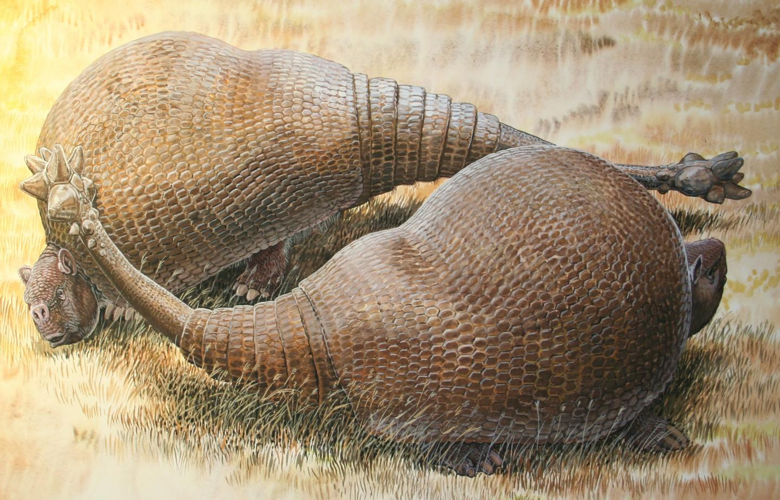



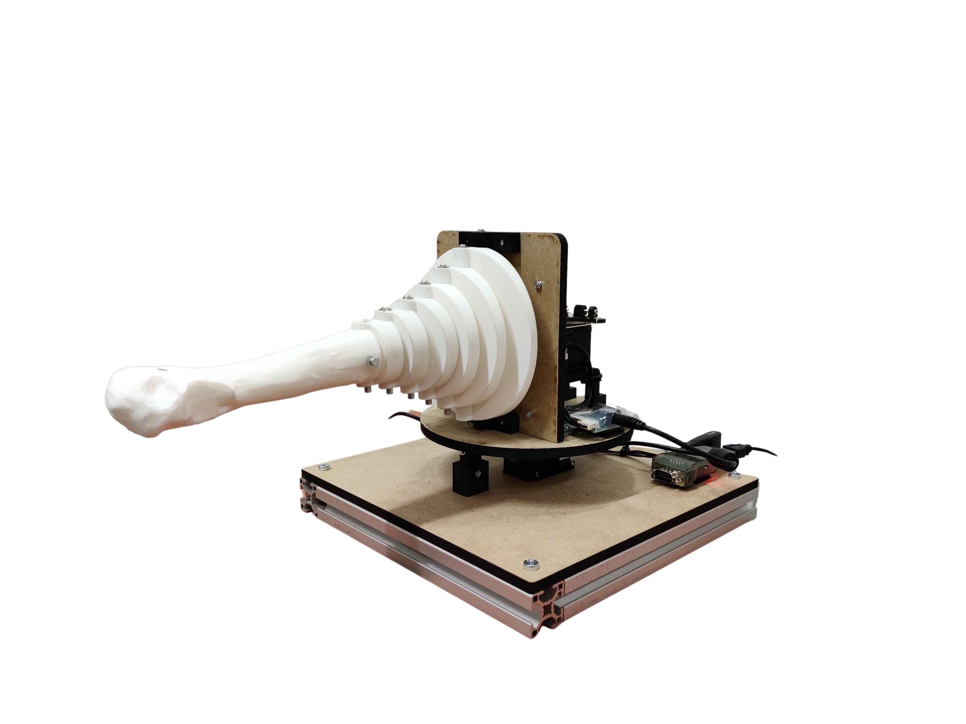
Unraveling the potential of a biological hammer through biorobotics Application on Doedicurus
Olivier Lonneux
Master thesis presentation
Image: Peter Schouten
July 14th 2023
Notes:
Hello
Im Olivier
Called : Unraveling the potential of a biological hammer through biorobotics
Application on Doedicurus

Slide 2
Outline
Introduction
What is a Doedicurus ?
Goal and motivations
State of the Art
Design and method
Modelling
Simulations
Robot
Experimentations
Results
Velocity of impact
Analysis
Discussion
Takeaway
Critical assessment and outlook
Conclusion
Notes:
I will first talk about Doedicurus and the goal and motivation of the project
Then I will go through the design and method section, where I will explain my design choices and the experimentation process
Then I will present my results and analyse them
And finally we will go through the discussion and conclusion

Slide 3
Introduction
About glyptodonts
Motivations and goal
State of the art
Project overview

Slide 4
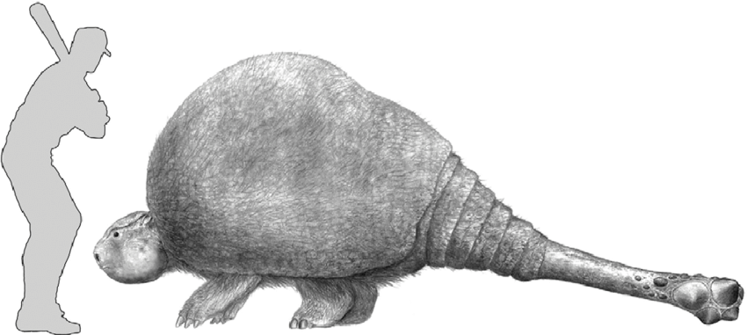
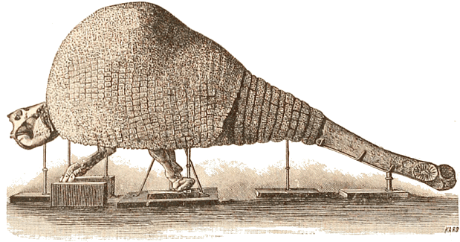
What is a Doedicurus?
Doedicurus is an extinct genus of glyptodont (Mammalia: Xenarthra), containing one species: D. clavicaudatus
Glyptodont were giant South Americans armadillos of the Pleistocene era that had bony armor covering their entire body
Doedicurus weighted approximately 1.5 tons and was almost 4 meter long
It had an impressive bony sheath at the distal end of its tail
This club could weight up to 65 kg and was around 1 meter long
The purpose of such clubs raises intriguing questions of research
Antagonistic purpose ?
Intraspecific combat or defense against predators ?
Damage potential ?
Artistic reconstruction of Doedicurus with a human for scale
from E. Bianco et al. (2009)
Illustration of a skeleton, James D, Dana
Notes:
Proximal – distal
Doedicurus..
Glyptodont..
From 50 millions years ago to 10000 years ago
Weight length
Like some other genus of glyptodont, it had an impressive bony sheath at the distal end of its tail which was likely equipped with spikes
This animal was really equipped for fight, like a knight in armor swinging a mace
This club could weight up to 65 kg and was around 1 meter long, making it the biggest one among glyptodont
Purpose
Most common opinion today is that it was used for intraspecific combat only and that it could break congeners carapace as fractures were found on some of them

Slide 5
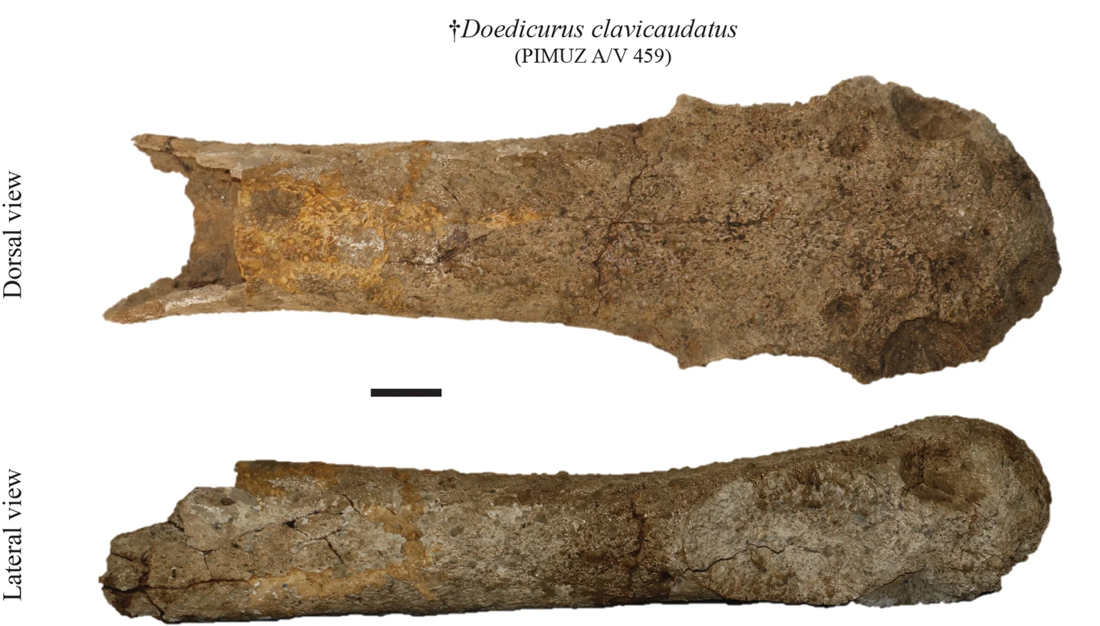
Motivations and goal
The Palaeontological Institute and Museum of the University of Zurich (PIMUZ) is currently housing xenarthrans fossils from the collection of Santiago Roth
Among the specimens, there is a fossilized Doedicurus caudal tube (PIMUZ A/V 459)
This gave the opportunity to contribute to the research on such clubs
The goals of this thesis are to gain insight intro the uses of such hammer by:
Estimating the impact potential of a tail swing
Finding out the optimal strategy of motion
Dorsal and lateral view of the tail club, scale bar is 10 cm, Kevin Le Verger, 2023
Notes:
Santiago (Kaspar Jakob) Roth (1850–1924)
Doedicurus likely used this tail for antagonistic purpose
This means the tail traits probably evolved to satisfy 2 objectives:
Inflicting damages
Limiting the amount of energy used
The optimal strategy was also the one which was most likely used
This thesis focused on investigating the impact potential of a tail swing as well as the optimal strategy of motion to hopefully gain insight into the uses of such hammer

Slide 6
State of the art
In 1999, Alexander, R. M. and colleagues estimated the potential energy of impact of a Doedicurus tail strike and concluded that it would be sufficient to fracture a congener's carapace
In 2005, K. Carpenter and colleagues estimated the impact force of a Stegosaurus tail
In 2009, V.M. Arbour reused this method to estimate the impact force of an Ankylosaurus tail club
In 2009, Bianco R.E. and colleagues estimated the position of the centre of percussion in glyptodonts’ tail club
This thesis builds on those previous studies and complements them with robotic tools, such as simulations and a robotic model
Notes:
Carpenter more complex
Robotic approaches can be valuable to study the motion of animals and have been applied to all sort of locomotion
Such approach can also be applied to paleontology to identify the likely motion of an extinct animal (OroBOT project)
A similar approach can be applied to the motion of a Doedicurus’ tail

Slide 7
Project Overview
Identifying the specifications of the tail movement
Kinematic of the movement (number of joints in the tail, body rotation…)
Muscles involved → maximum forces powering the movement
Design of simulations mimicking the tail movement
Motor-driven
Tendon-driven
Prototyping of a robot mimicking the tail movement
Experimentations and analysis

Slide 8
Design and method
Modelling and specifications
Simulations
Robot
Experimentations
Notes:
6:00

Slide 9
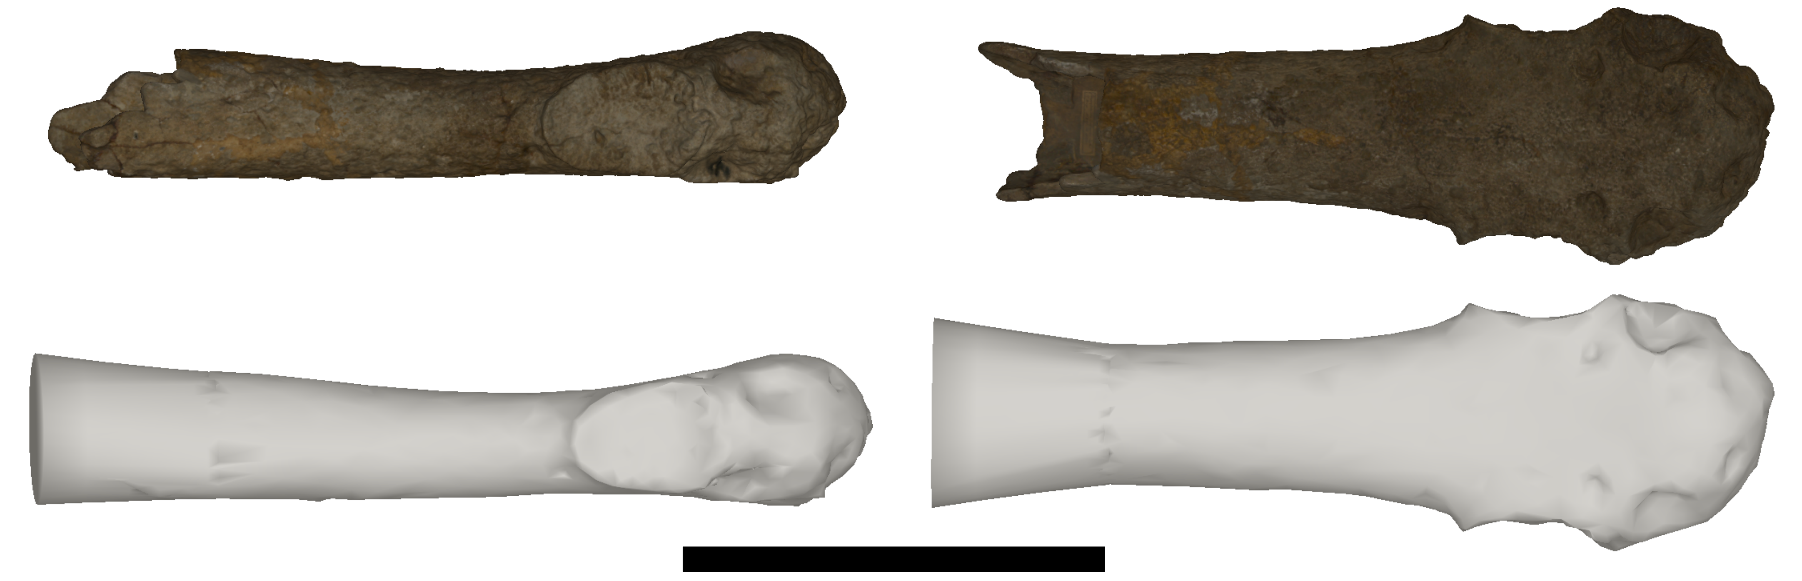
Tail modelling
The caudal sheath available at PIMUZ is incomplete
It was completed to reach a total length of 1 meter
Weight of the club calculated using an 1800 kg/m³ density (Bianco E. et al., 2009) →44 kg
Lateral and dorsal view of the original 3D scan of the club (textured) and the completed one (in white), scale bar is 50 cm
Notes:
most Doedicurus club have a length which is close to this value
(I first looked at the measurements from other club (E. Bianco et al. studies provide precise measurements of a Doedicurus club (MNHN 2205)
) but soon noticed there was a lot of discrepancy in the width to length ratio
Ultimately, it looked more coherent to subjectively set the length of the tail club to 1 meter, since most Doedicurus club had a length which is close to this value)

Slide 10
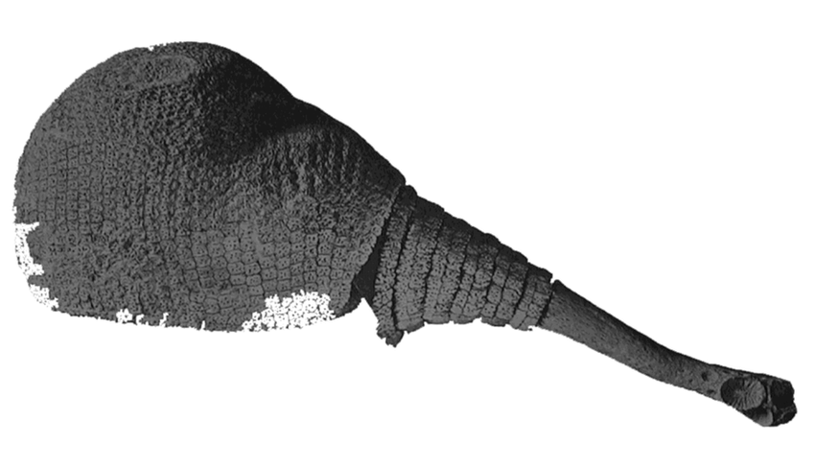
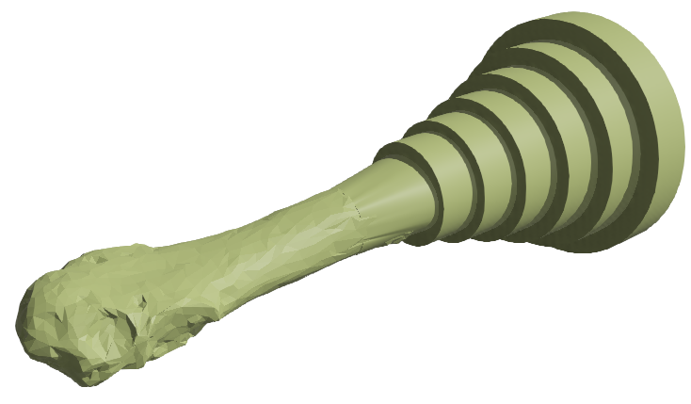
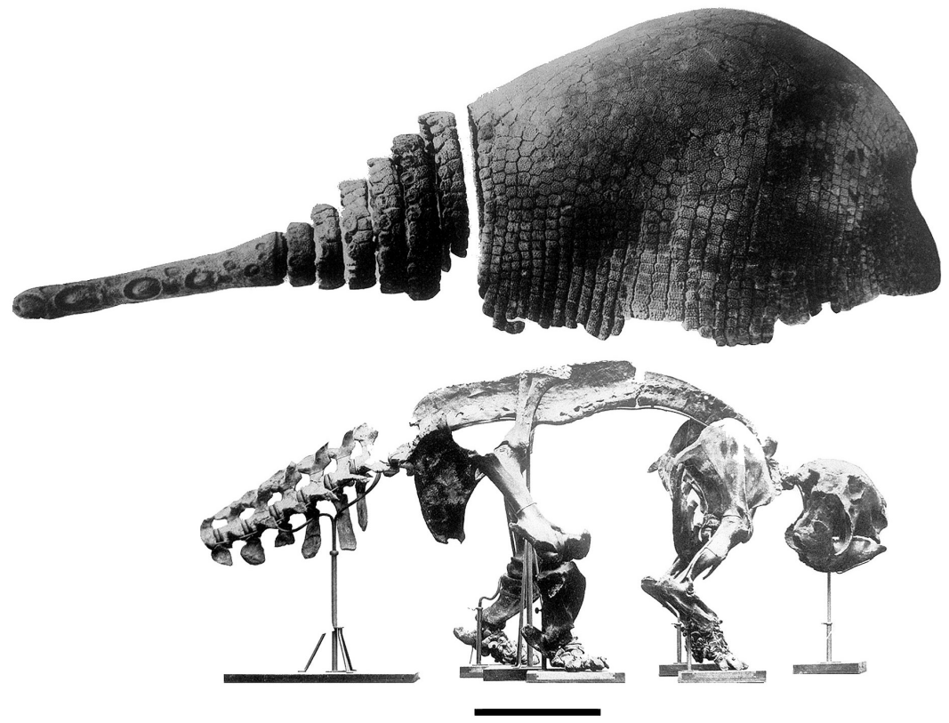
Tail modelling
Doedicurus armor was composed of 6 ring scutes
For Panochtus, another genus of Glyptodont, each ring scutes is connected to a caudal vertebra
Assumed to be the same for Doedicurus → tail modelled as 6 cylinder with a hinge joint between each of them
Volume and weights of each segment derived from previous estimations (Alexander R.M. et al., 1999)
Lateral view of a complete armour of Doedicurus, Richard A. Fariña (2002) D
Lateral view of the carapace and the skeleton of Panochtus, modified from Lydekker by Zamorano M. et al. (2012)
Notes:
No representations of Doedicurus caudal vertebrae available
Volume of bones and muscles

Slide 11
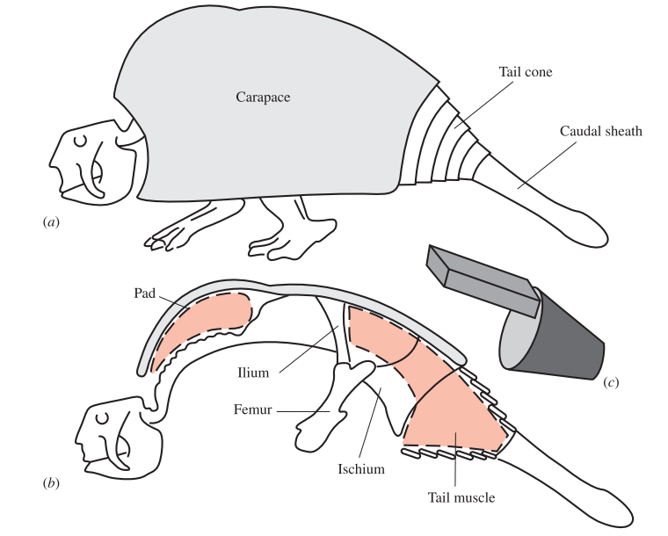
Muscles model
Tail muscles under the ring scutes can be represented with a truncated cone (Alexander R.M. et al., 1999)
Parallelepiped representing an extension of the tail muscles (ibid.)
0.105 m³, 108 kg of muscles powering the tail
Muscles model (Alexander et al., 1999)
Notes:
More than a hundred kg of muscles powering the tail
Volume → crosssectional area and length from observations

Slide 12
Forces and torques
Contraction force in each segment computed by multiplying half the muscles cross-sectional area by 20 N/cm² (specific tension for concentric contraction, (V.M. Arbour, 2009))
Torques rotating each segment computed by multiplying half the length of the muscles by the contraction force
Segment | Cross sectional area of muscle [cm²] | Force [kN] | Muscle width [cm] | Torque at base of link [Nm]
1 | 810 | 8.10 | 40 | 1620
2 | 2190 | 21.90 | 11 | 1205
3 | 1521 | 11.21 | 11 | 836
4 | 1056 | 10.56 | 11 | 581
5 | 733 | 7.34 | 11 | 403
6 | 509 | 5.09 | 11 | 280
Club | 354 | 3.54 | 11 | 195
Forces and torques in each of the segment of the tail

Slide 13
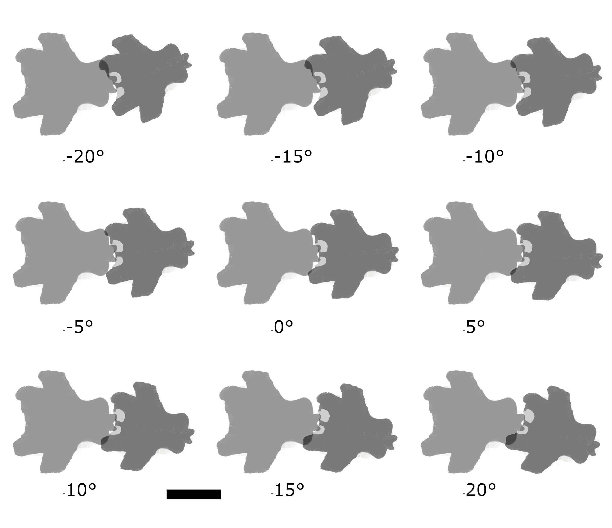
Vertebrae mobility
Prezygapophysis
The half-angle of mobility of vertebrae was defined using the variations of the overlap area of postzygapophysis and prezygapophysis when rotating 2 caudal vertebrae with each other
Minimum overlap should be between 1/8 and a 1/4 of the maximum overlap (V.M. Arbour, 2009)
In the absence of Doedicurus vertebra, a vertebra of Glyptodon Minuzi was used
The half-angle of mobility was likely around 10 degrees and almost certainly below 15 degrees
Postzygapophysis
Vertebrae assembly in dorsal view, prezygapophysis are in light grey
Notes:
1.5 cm intervertebrate disc
Between 1/8 and a ¼ of the maximum overlap value
Can explain later

Slide 14
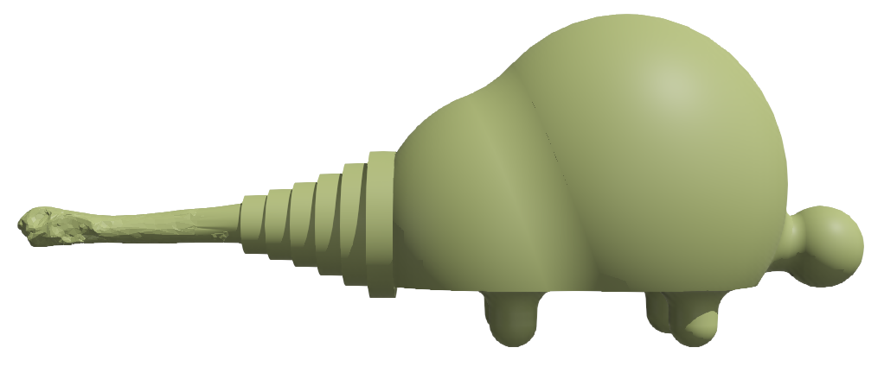
Body rotation
A swing of the tail may have been accompanied by a rotation of the body to increase the power output
Doedicurus agility was likely near the one of a buffalo and it was hypothesized it could stand on 2 legs (Vizcaíno, S. et al., 2011) → body rotation may be up to 60° (Fariña, R.A., 1995)
A body rotation of 30° was taken as an initial value, with a maximum rotation speed estimated at 5 rad/s
Complete model used in the simulations
Notes:
60 degree → upper bound
(for reference, a human can rotate its hips up to 10 rad/s when throwing a 6 kg medicine ball)

Slide 15
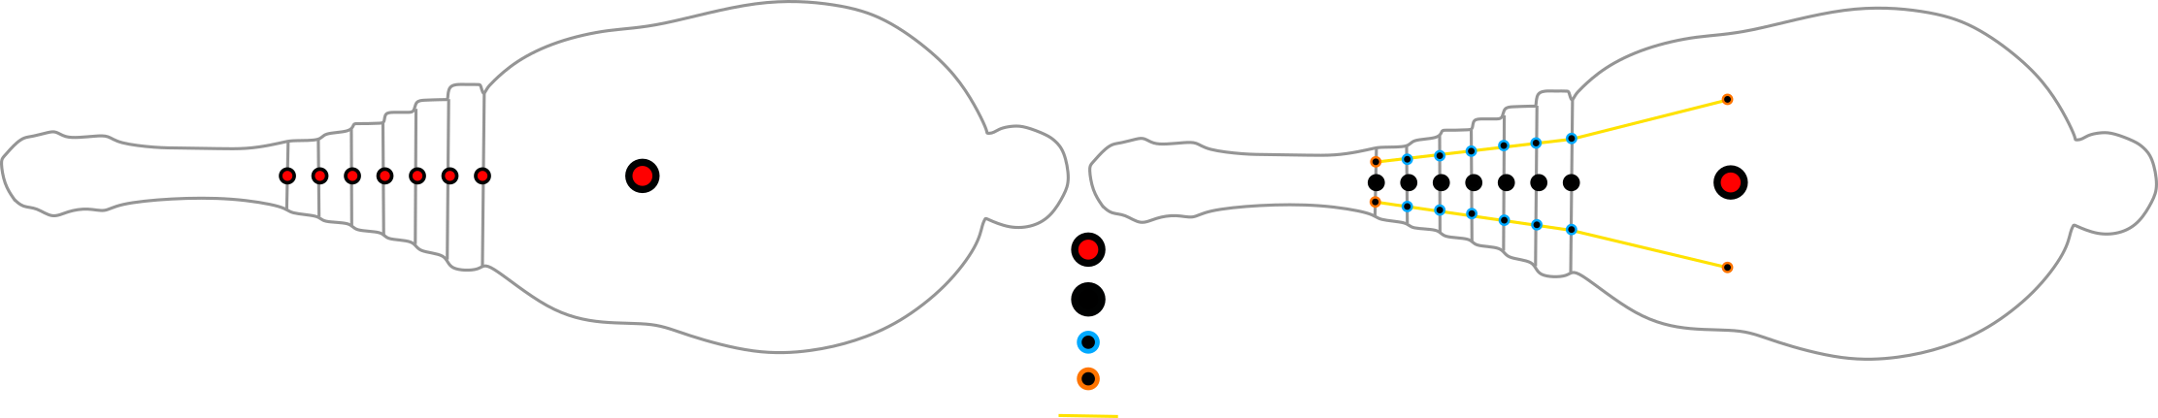
Simulations
Motor-driven
Tendon-driven
One motor for each joints
Maximum torques of motor corresponds to the calculated torques powering each joint
Made using Webots software
Tendons are closer to the functioning of real muscles
2 tendons, one for each side of the tail
Total forces corresponds to the sum of the muscles’ force in each segment
Made using Mujoco engine
Motorized hinge joint
Hinge joint
Tendon pass-trough
Tendon attach points
Tendon
Scheme of both simulations in top view
Notes:
Motor for body situated at the pelvic location

Slide 16
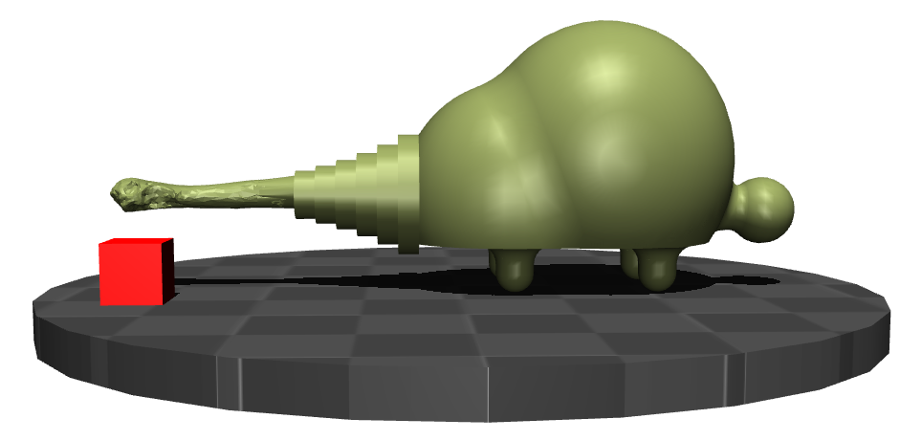
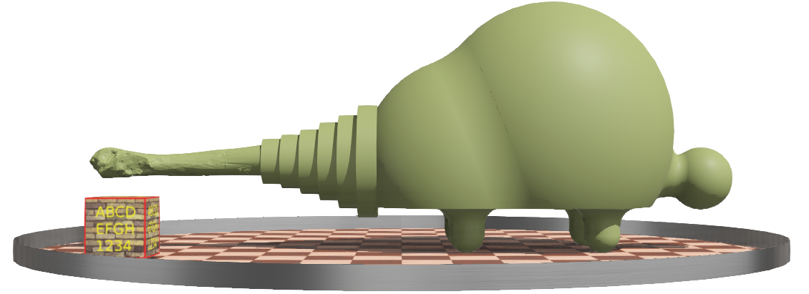
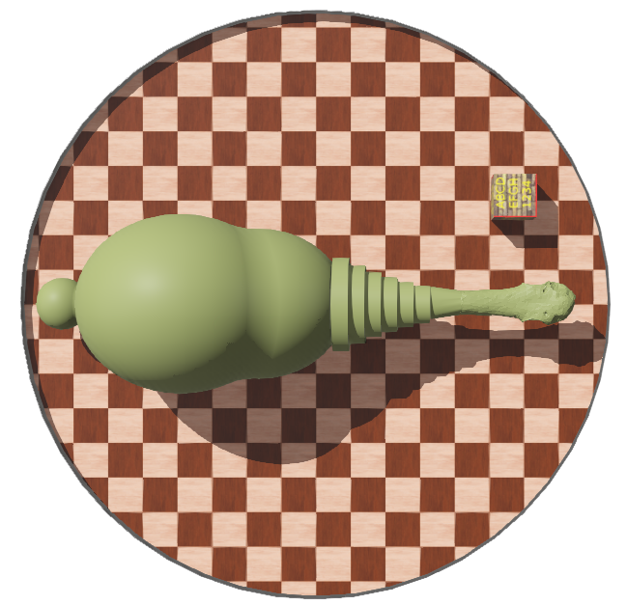
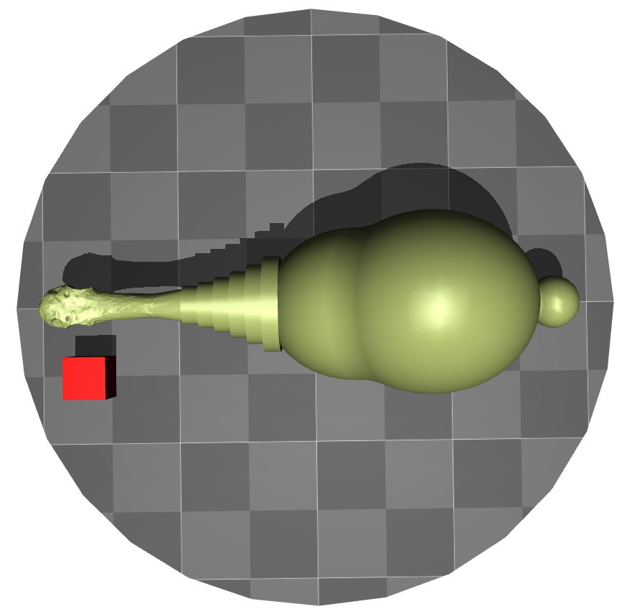
Simulations
Motor-driven
Tendon-driven
Motor-driven simulation lateral and top view, box is 30 cm wide
Tendon-driven simulation lateral and top view, box is 30 cm wide

Slide 17

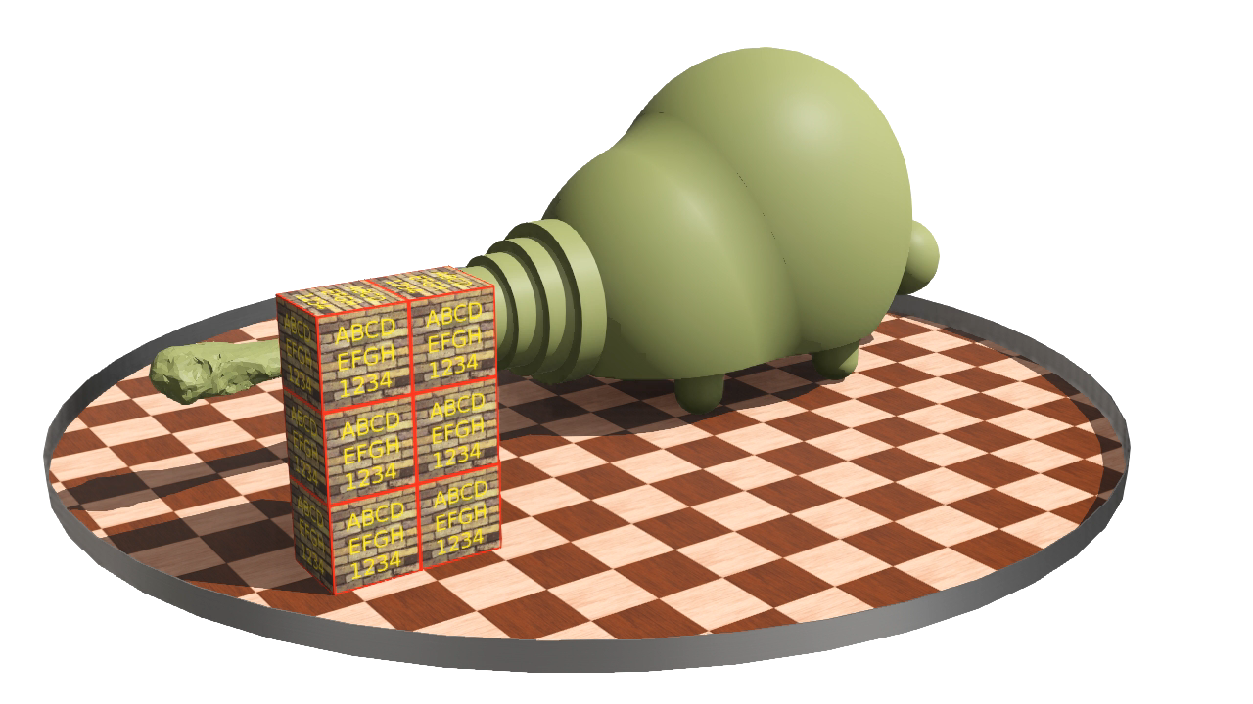
Simulations
Motor-driven
Tendon-driven
Notes:
Each boxes is 30 kg heavy

Slide 18
Robot
1/6 scale
Tendon-driven to limit the number of necessary motor
A rotating platform simulate the body movement
Photo of the robot, frontview

Slide 19
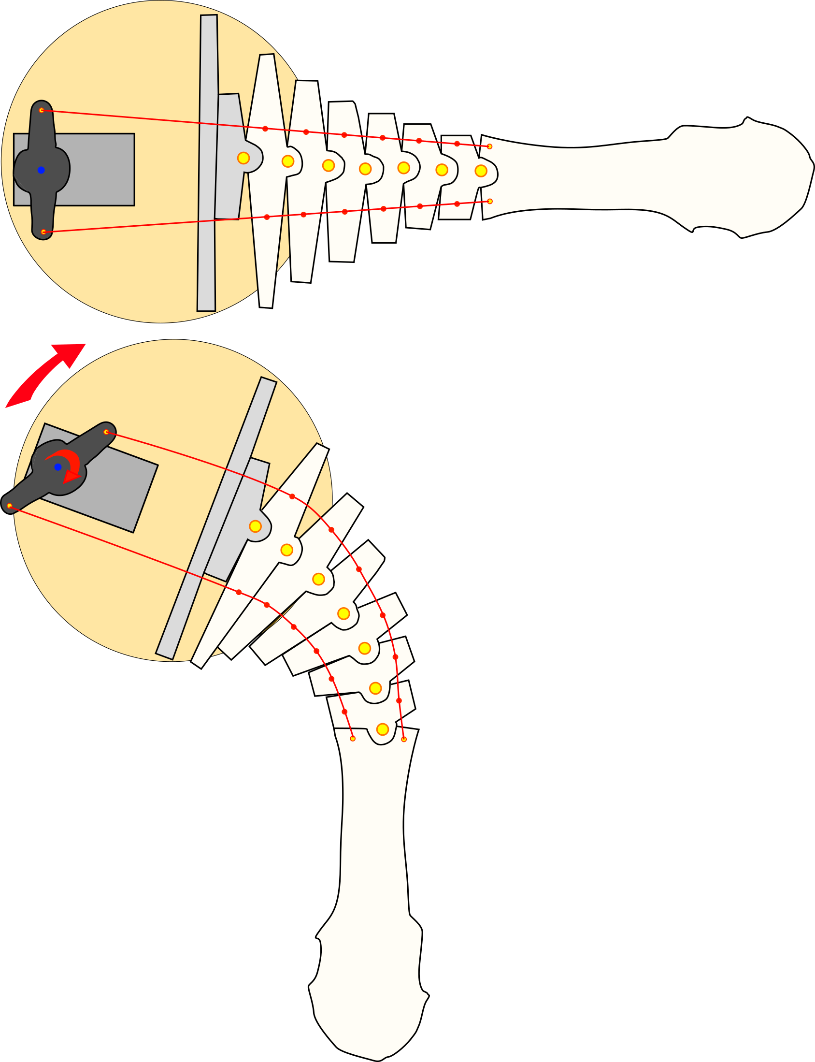
Robot
Motor
Rotating platform
Tendons
Hinge joints
Pass-through
Attach points
Club
Scheme of the functioning of the robot

Slide 20
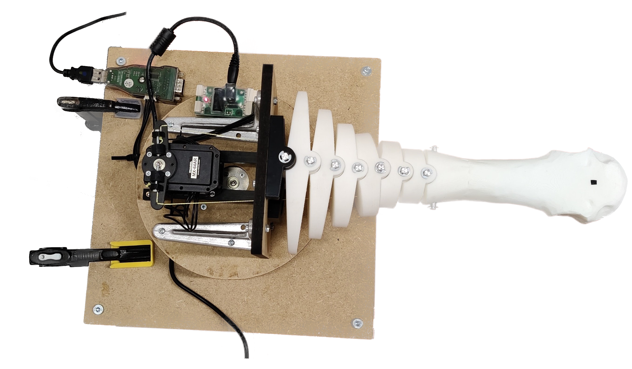
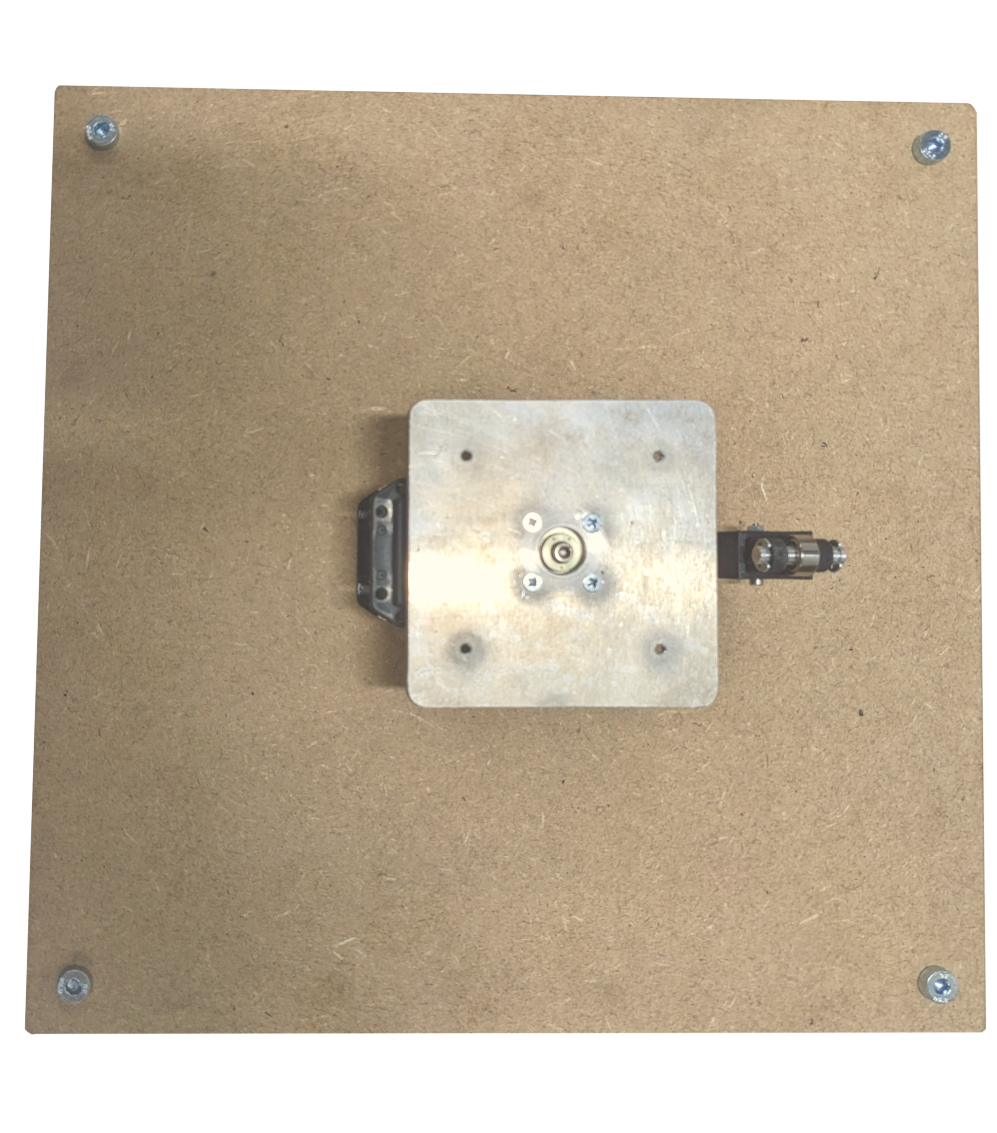
Robot
Aluminium plate
Alimentation
USB control
Vertical plate
Club
Dynamixel MX-64 servo motor
Dynamixel MX-64 servo motor
Ball bearing support
Horn
Aluminium axis + Teflon inserts
Square base
Vertebrae
Tensioning system
Components of the robot
Rotating platform
String
Notes:
5 degrees inclined facet to limit rotation
Tensioning system
Each segment have correct weight
HPPE braided line, very resistant

Slide 21
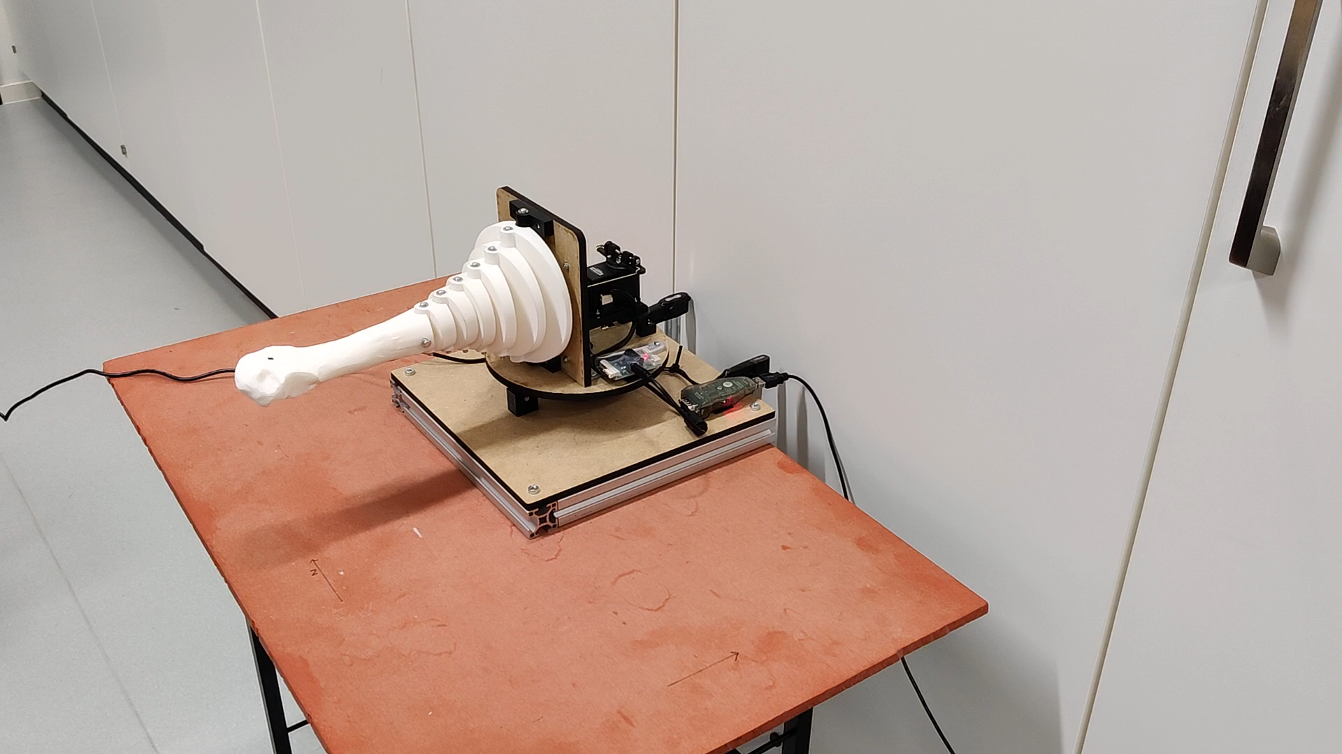

Slide 22
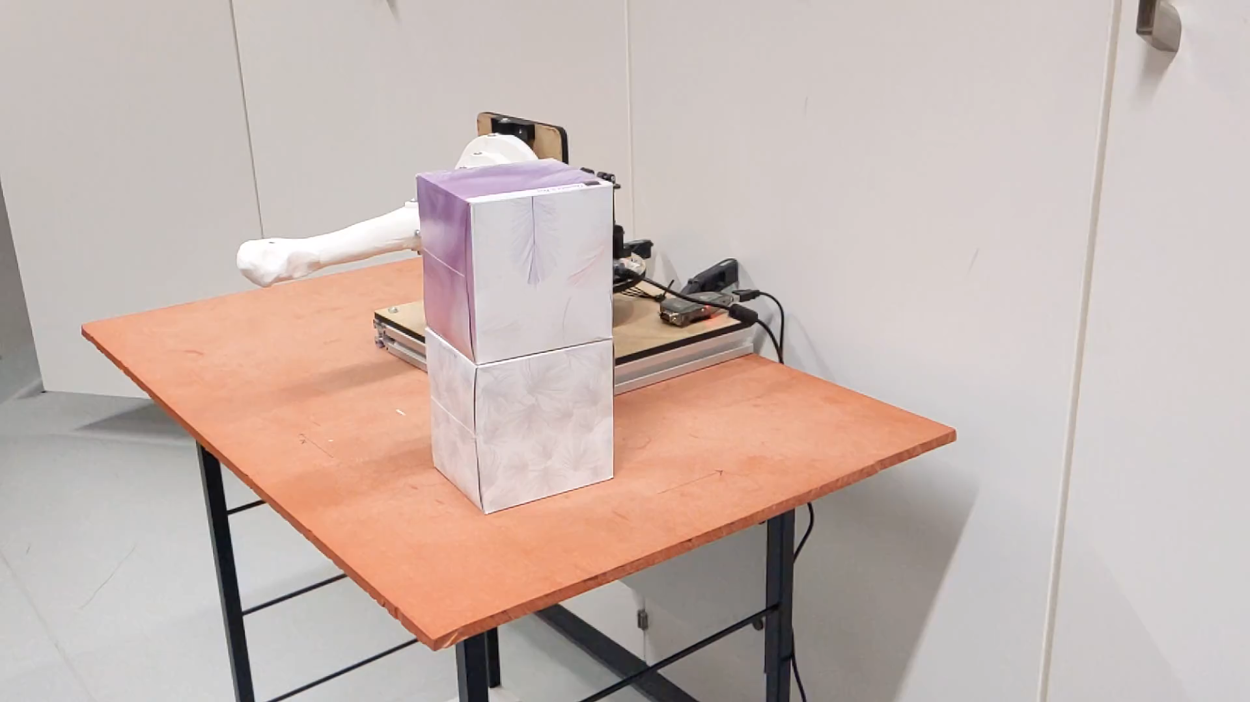

Slide 23
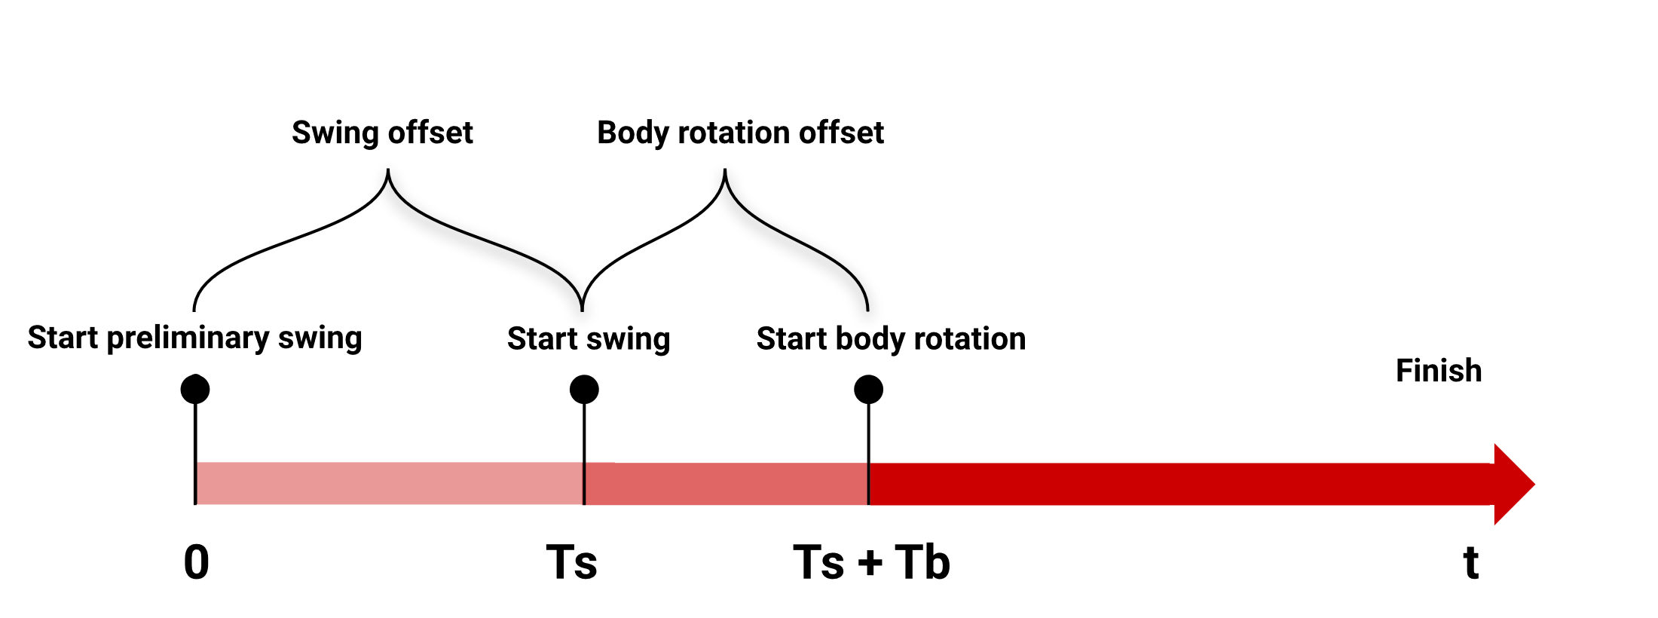
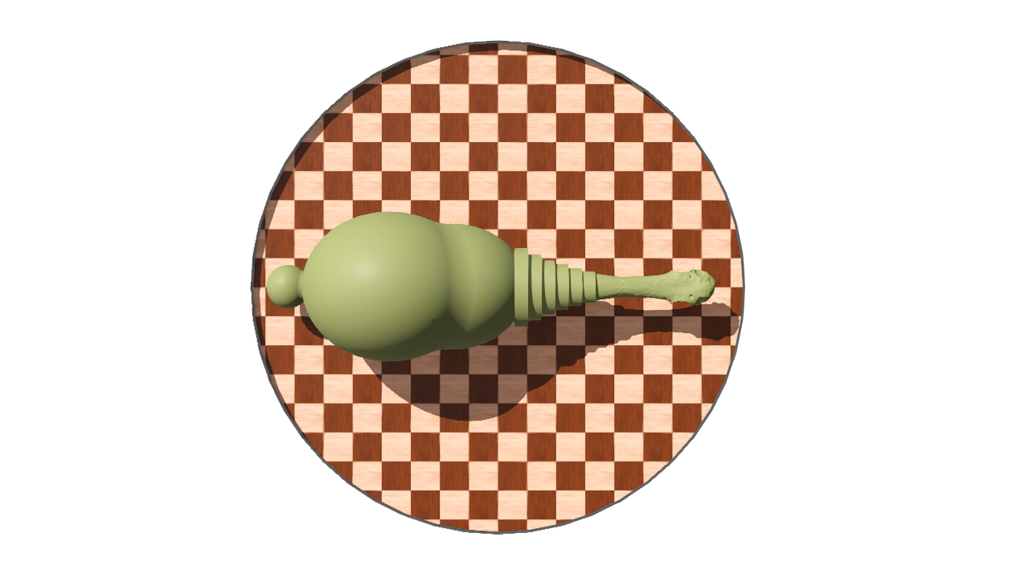
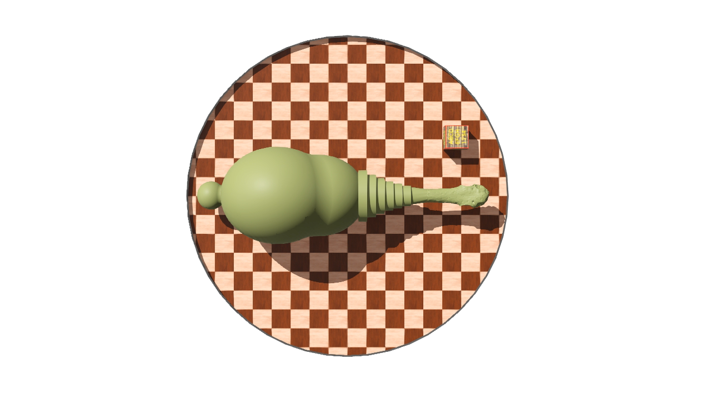
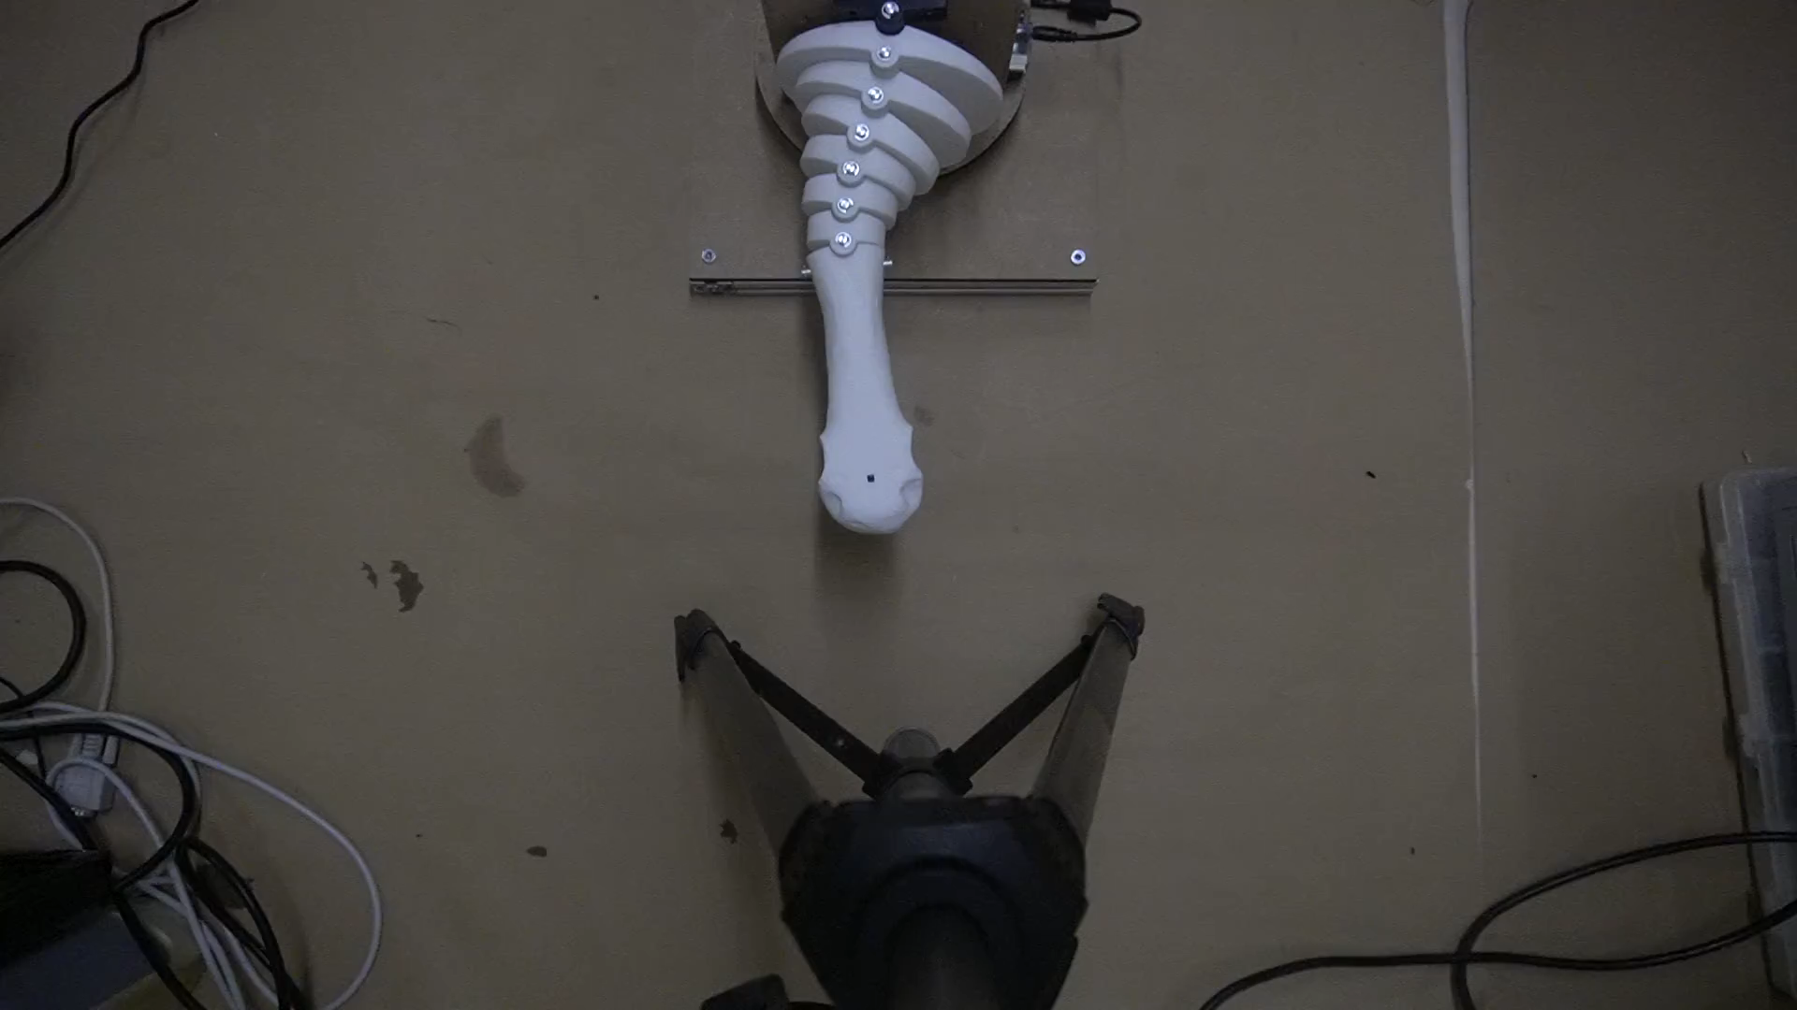
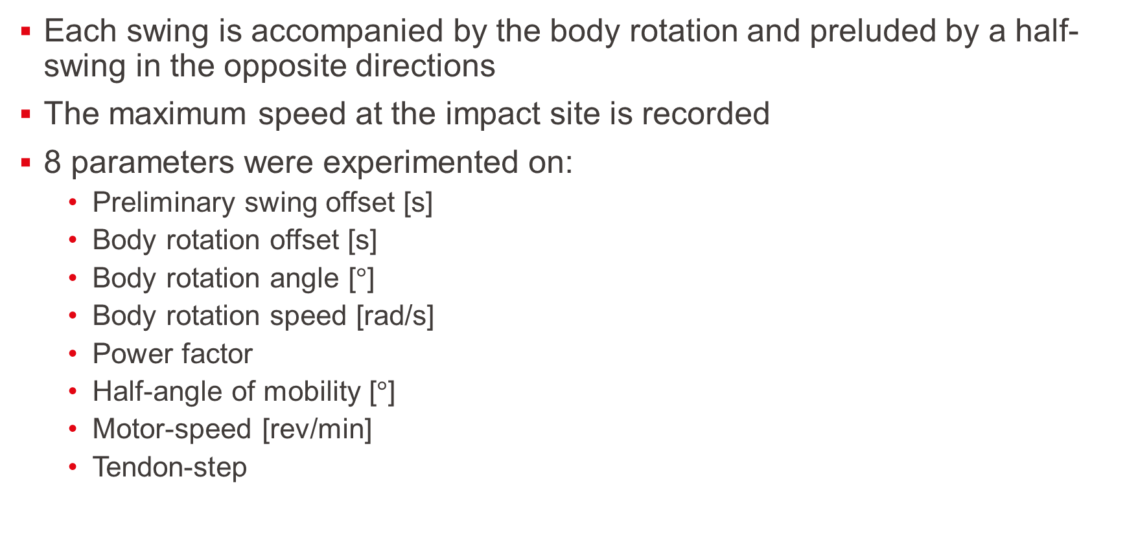
Experimentation protocol
Each swing is accompanied by the body rotation and preluded by a half-swing in the opposite directions
The maximum speed at the impact site is recorded
8 parameters were experimented on:
Preliminary swing offset [s]
Body rotation offset [s]
Body rotation angle [$°$]
Body rotation speed [rad/s]
Power factor
Half-angle of mobility [$°$]
Motor-speed [rev/min]
Tendon-step
Notes:
Impact site near the tip of the club, where possible spikes were located
0-0.8 swing offset
-0.4 to 0.4 body rotation offset
0 to 60 degrees rotation angle
0 to 10 rad/s body rotation speed

Slide 24
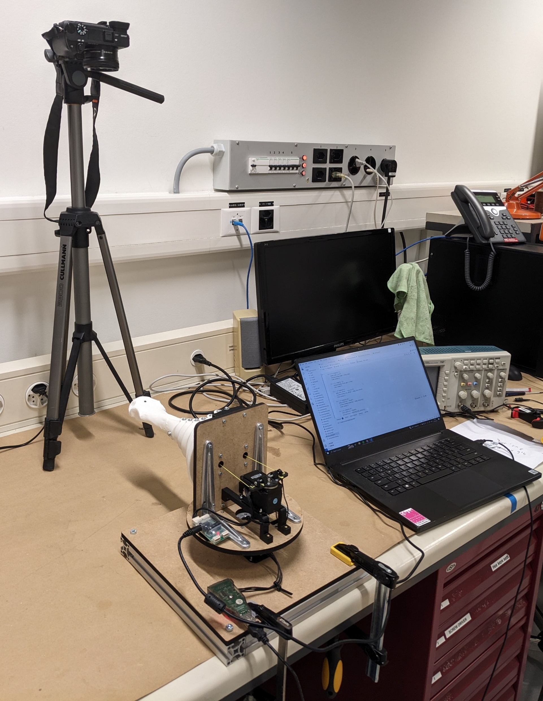
Experimentation setup
Camera
The robot is directly controlled by the computer
The movements are recorded using a Sony Alpha 6400 camera in top view
Settings were set to 60 fps and a 1/4000s shutter speed to remove motion blurring
Computer
Setup
Clamp
Robot
Notes:
I also clamped the robot to avoid any unnecessary movements

Slide 25
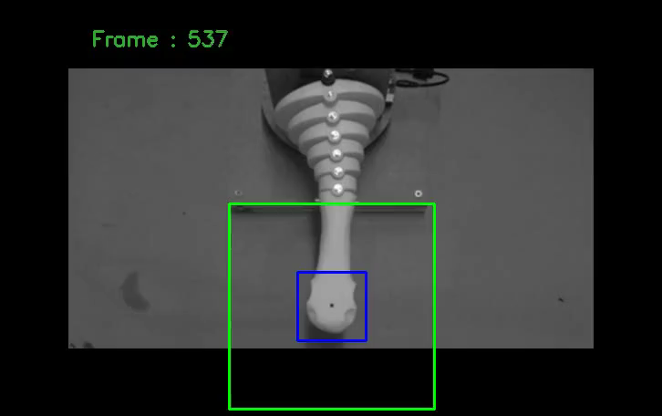
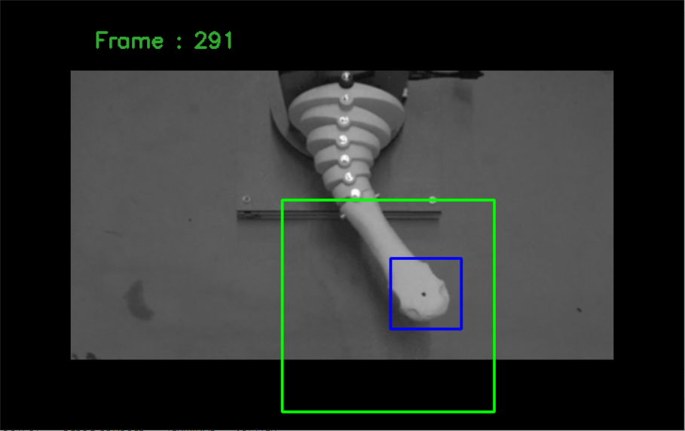
Computer vision
Best match
Both template matching and motion tracking algorithm were tried
Best results were obtained using template matching with 5 different templates
Templates corresponds to the tip of the club being rotated -90, -45, 0, 45 and 90 degrees
Tracking view
Area of research

Slide 26
Results
Typical velocity profile
Velocity of impact
Analysis
Summary

Slide 27
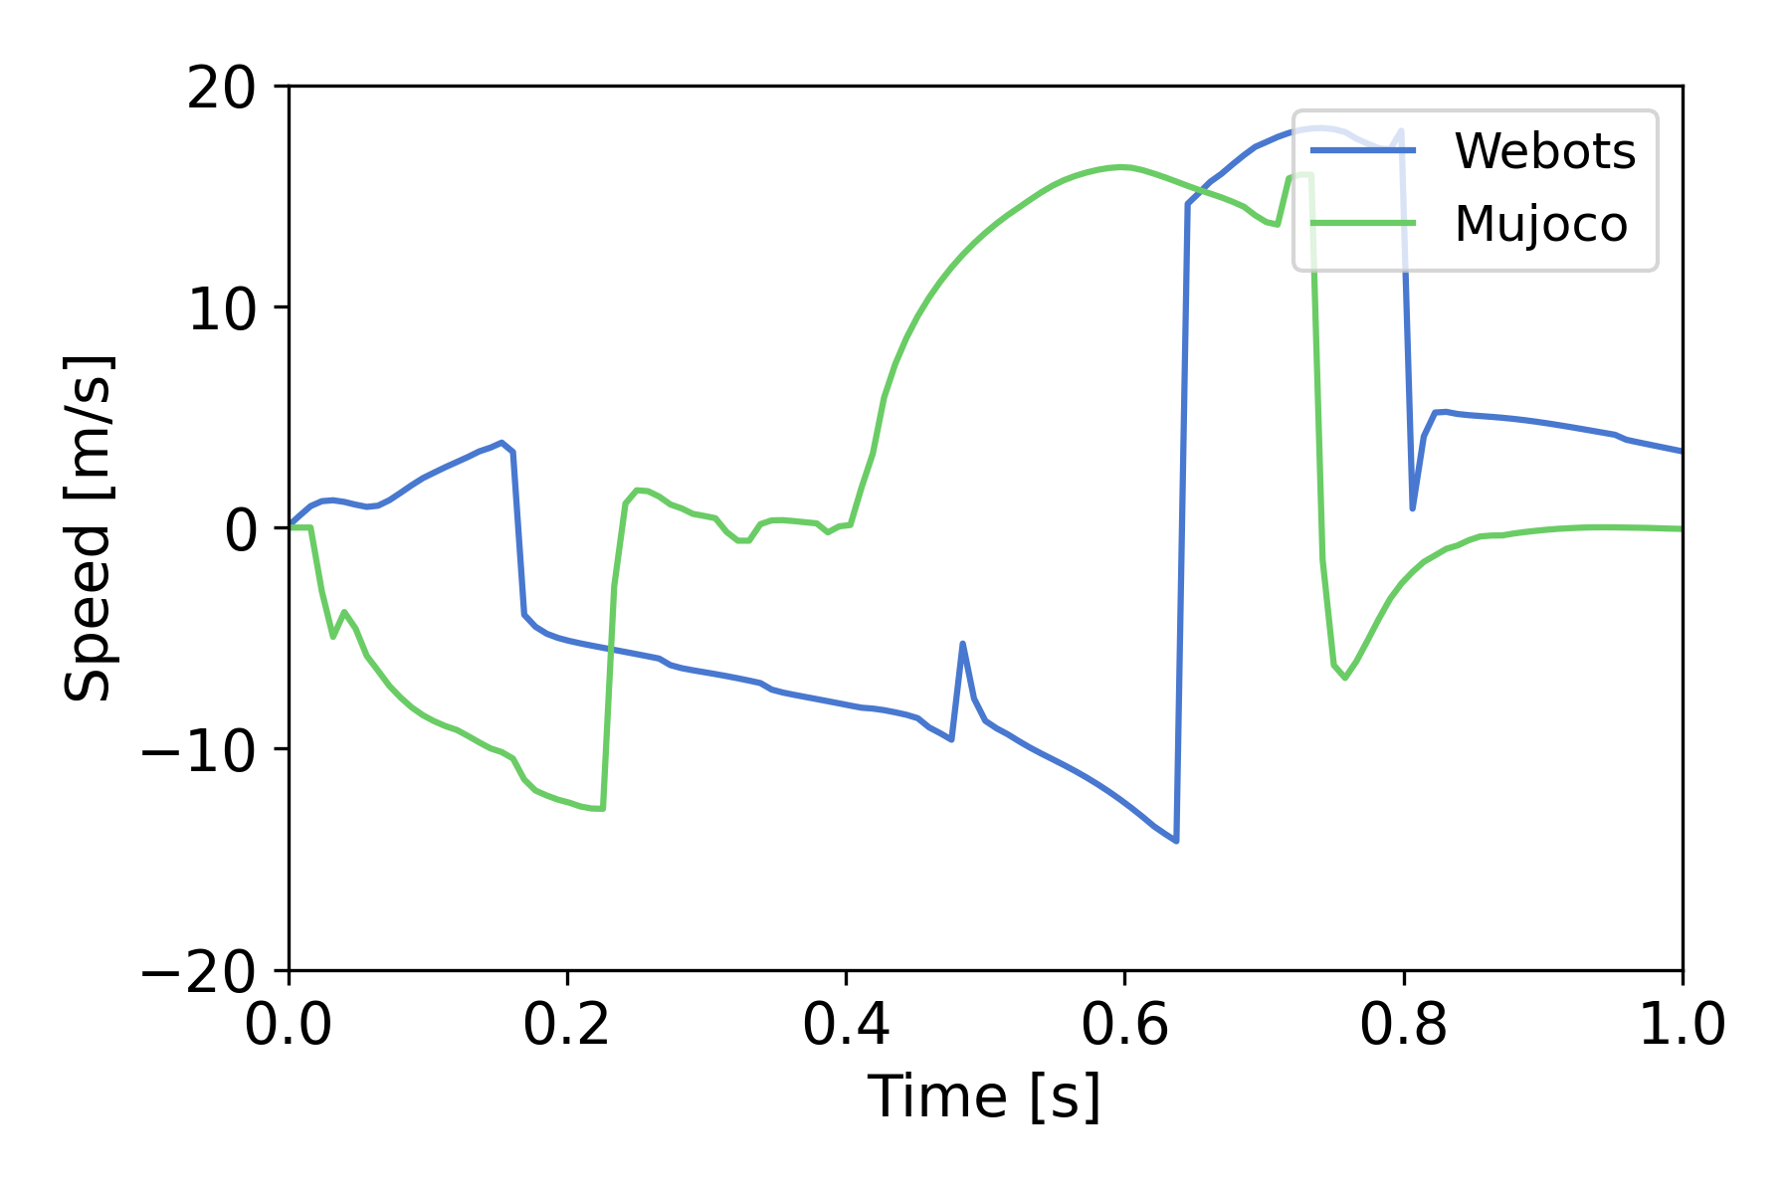
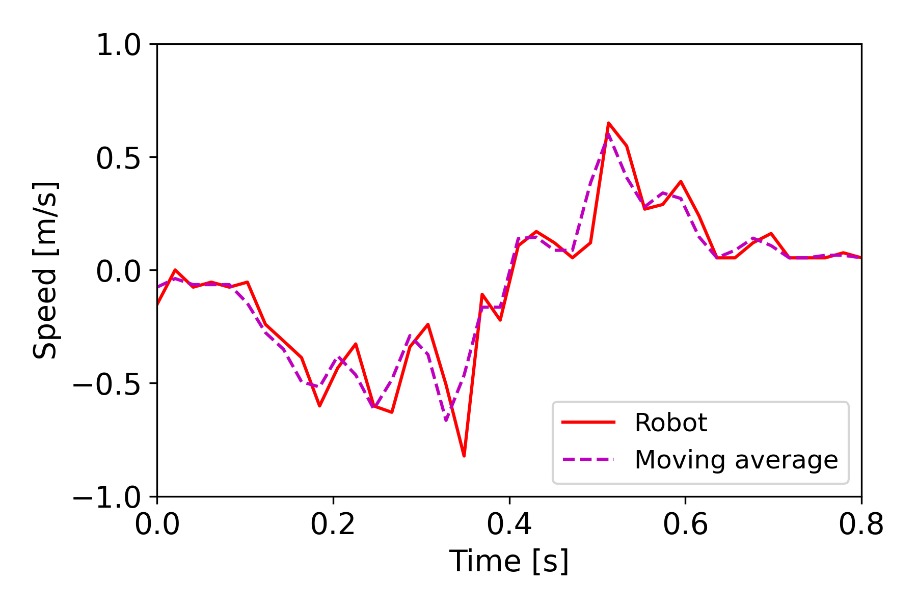
Typical velocity profile
Velocity profile with baseline parameters, simulations (left) and robot (right)
Tendon-driven system accelerates faster than motor-driven one
Maximum speed of the robot is lower than expected but average speed is more in line with simulations results
Notes:
18 m/s max motor-driven, 16 m/s max tendon-driven
Swing time similar in both robot and simulations

Slide 28
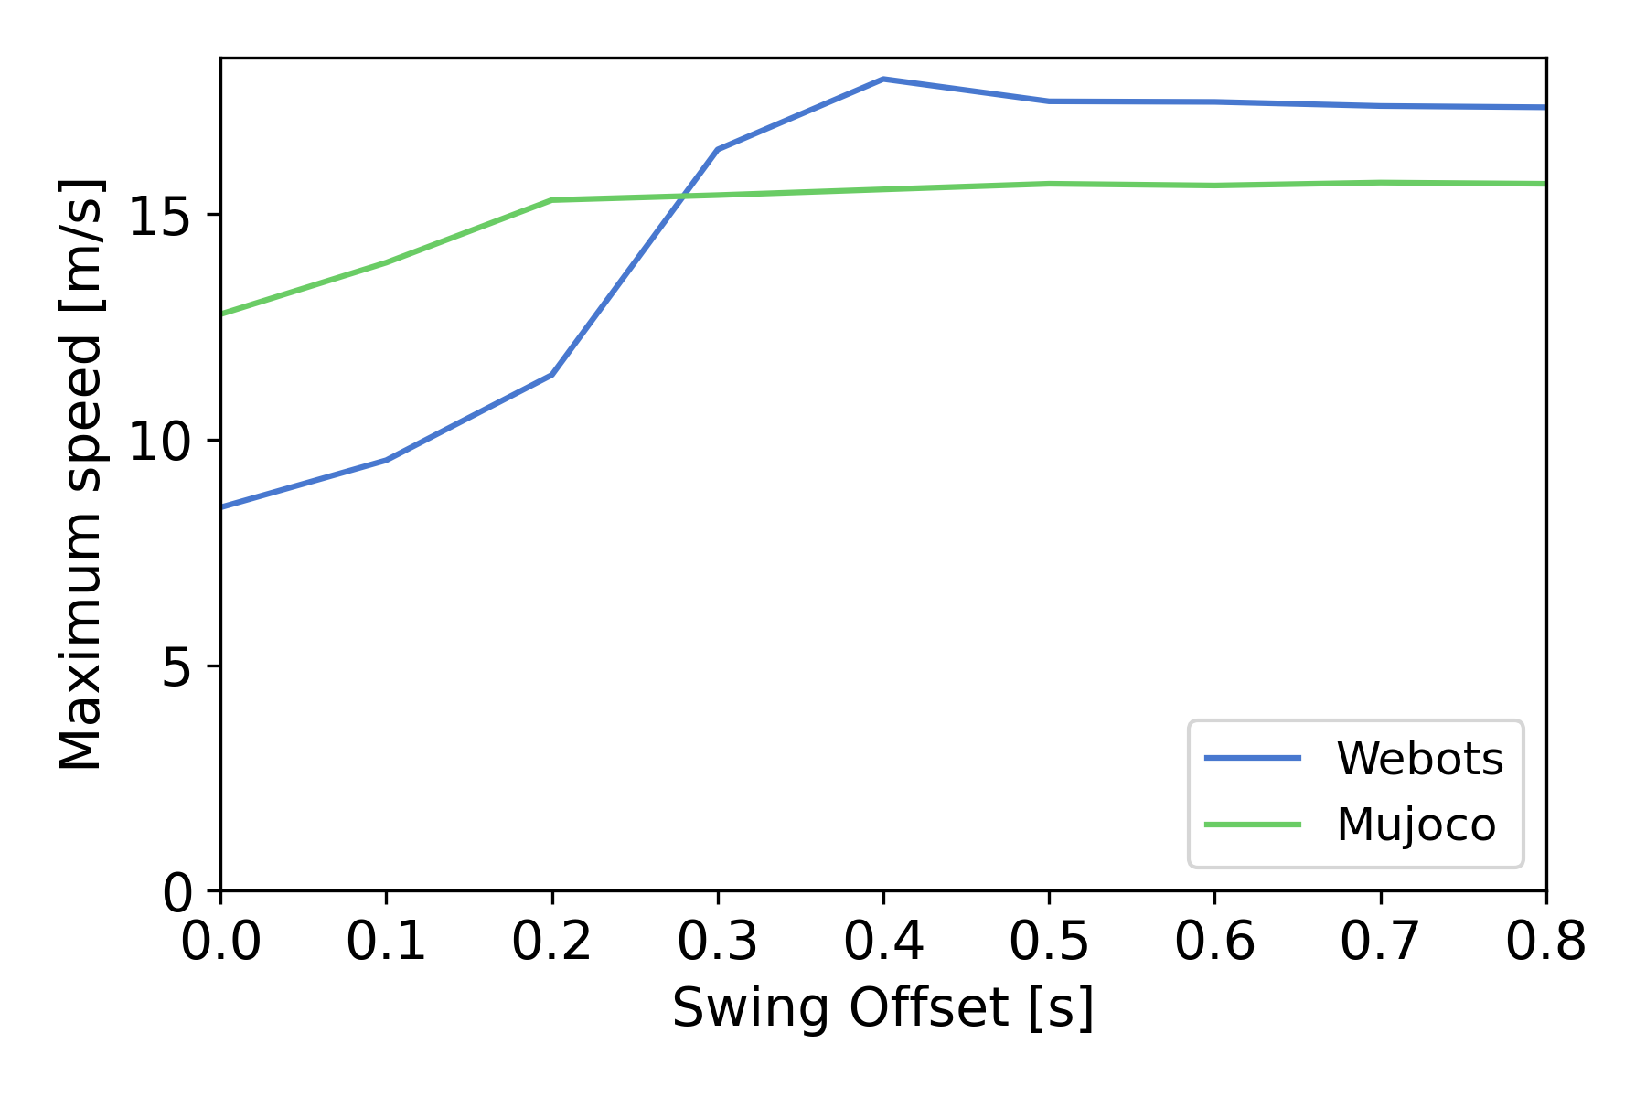
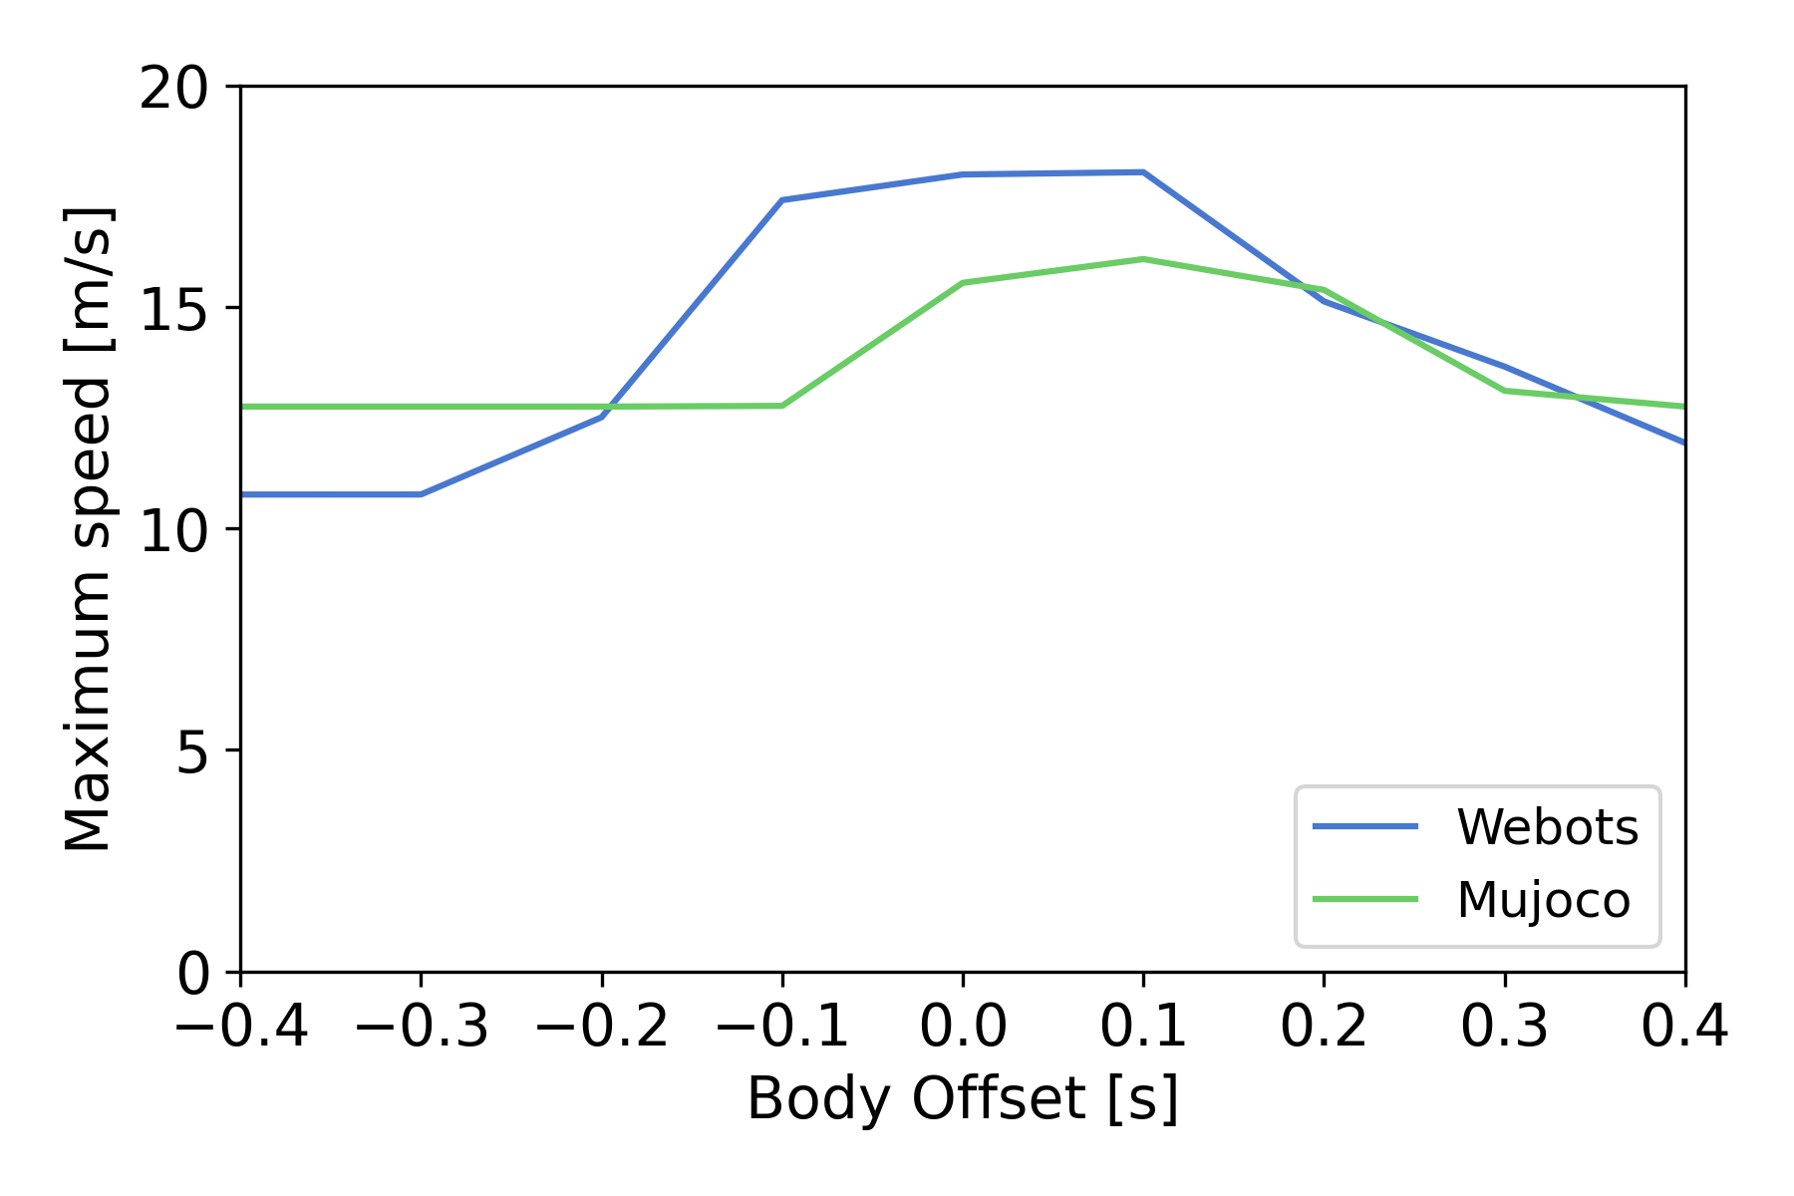
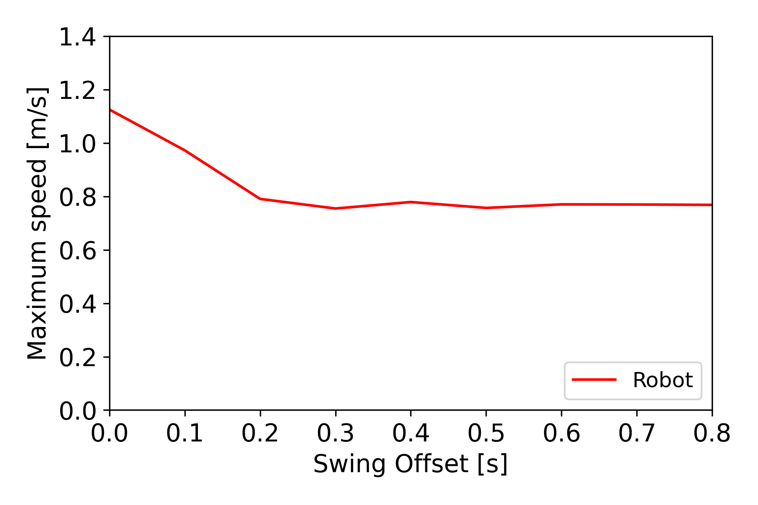
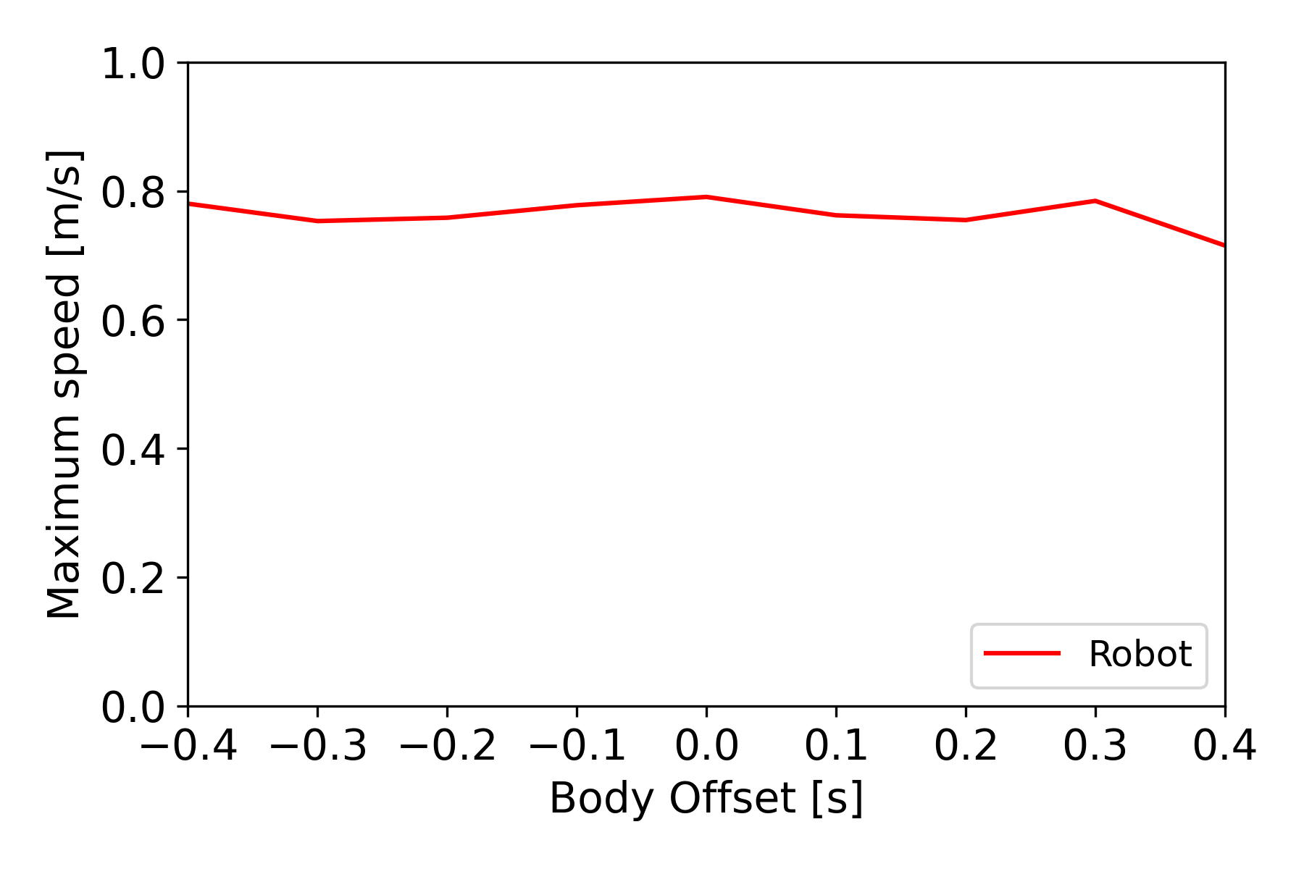
Velocity of impact
Impact of the swing offset on the maximum speed of impact
Impact of the body offset on the maximum speed of impact
Notes:
Gree, blue, red
In simulations, increase of velocity with swing offset
0s → only half-swing
Small peak for motor-driven simulation with correct timing → get some energy back
Not in tendon-driven
Peak with synchronized body rotation with swing
Nothing noticeable in robot experimentations
Swing offset: -53% webots, -18% Mujoco →-3% webots
Body offset: -40% W, -18% M → -34% W, -18% M

Slide 29
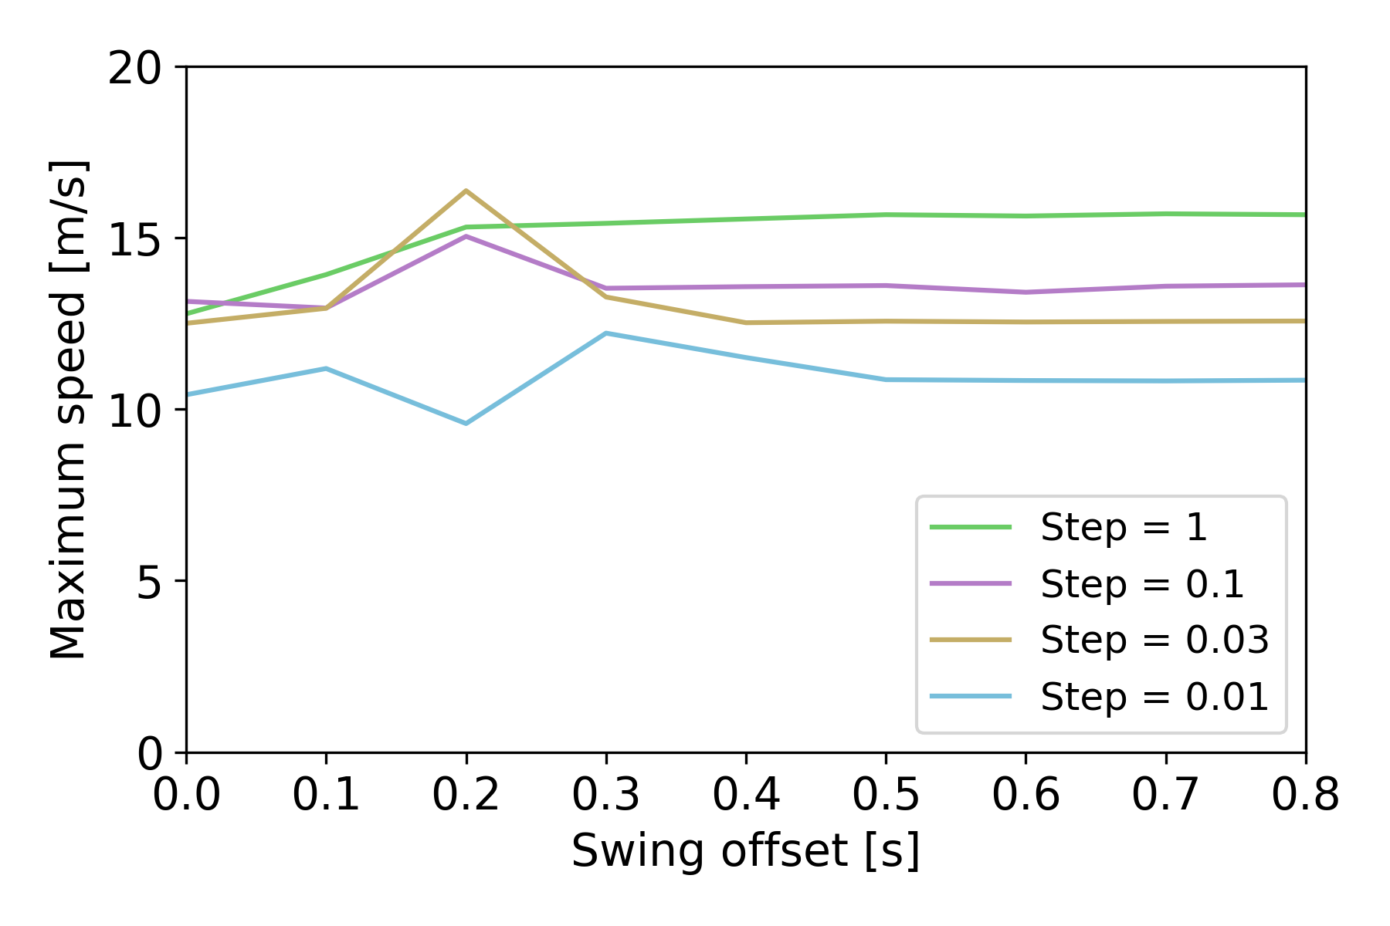
Velocity of impact
Impact of the swing offset with different tendon’s contraction speed in the tendon-driven simulation
Notes:
Tried with tendons → possible to get higher speed by lowering the speed of the tendon's contractions and timing the 2 swing perfectly

Slide 30
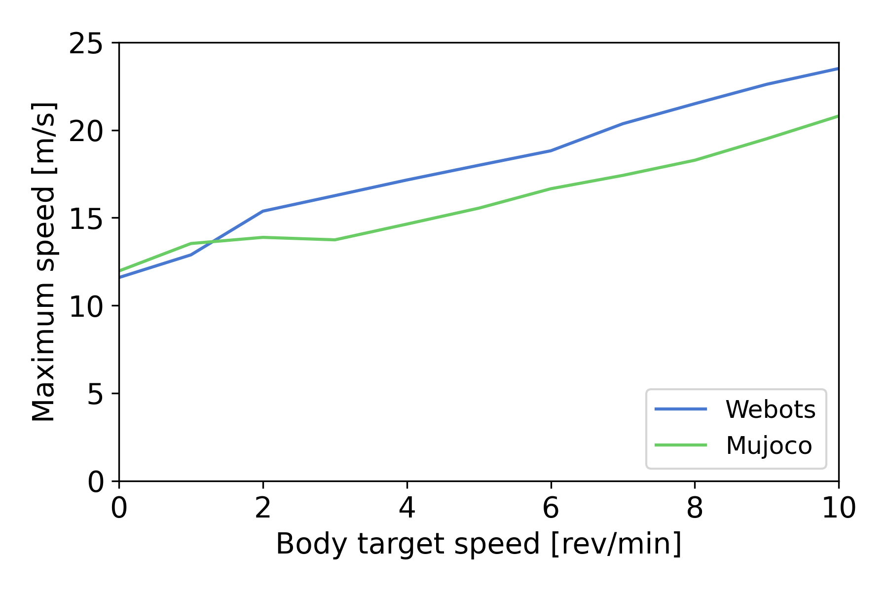
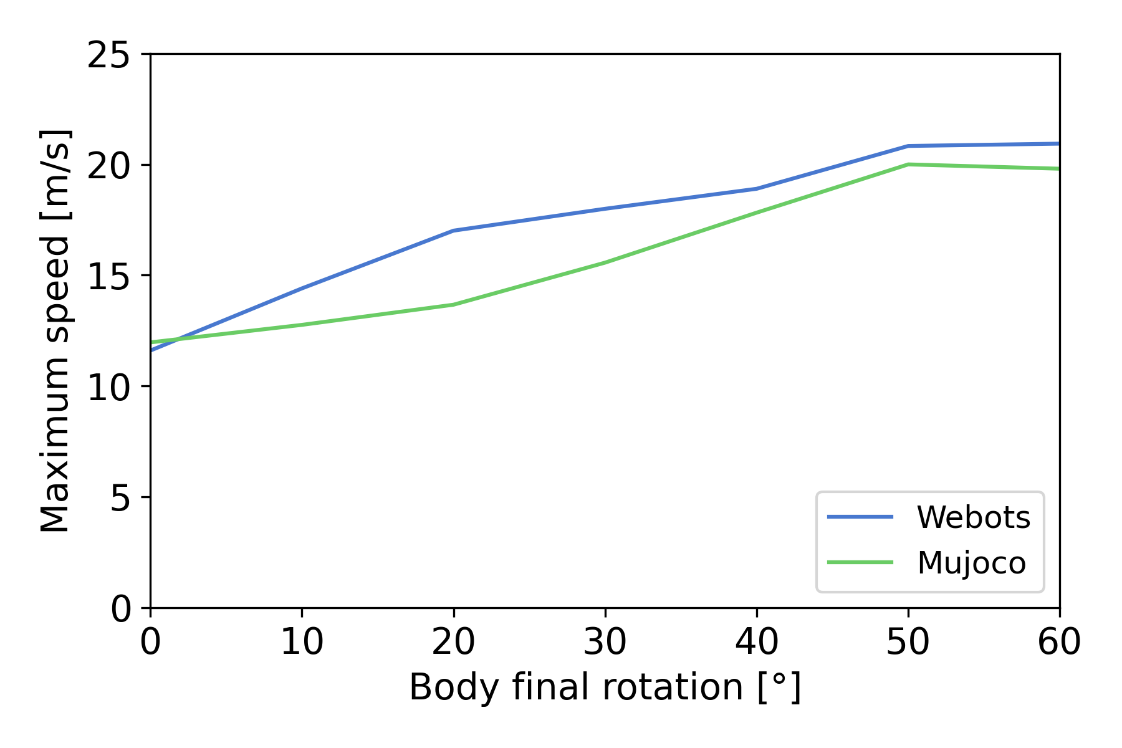
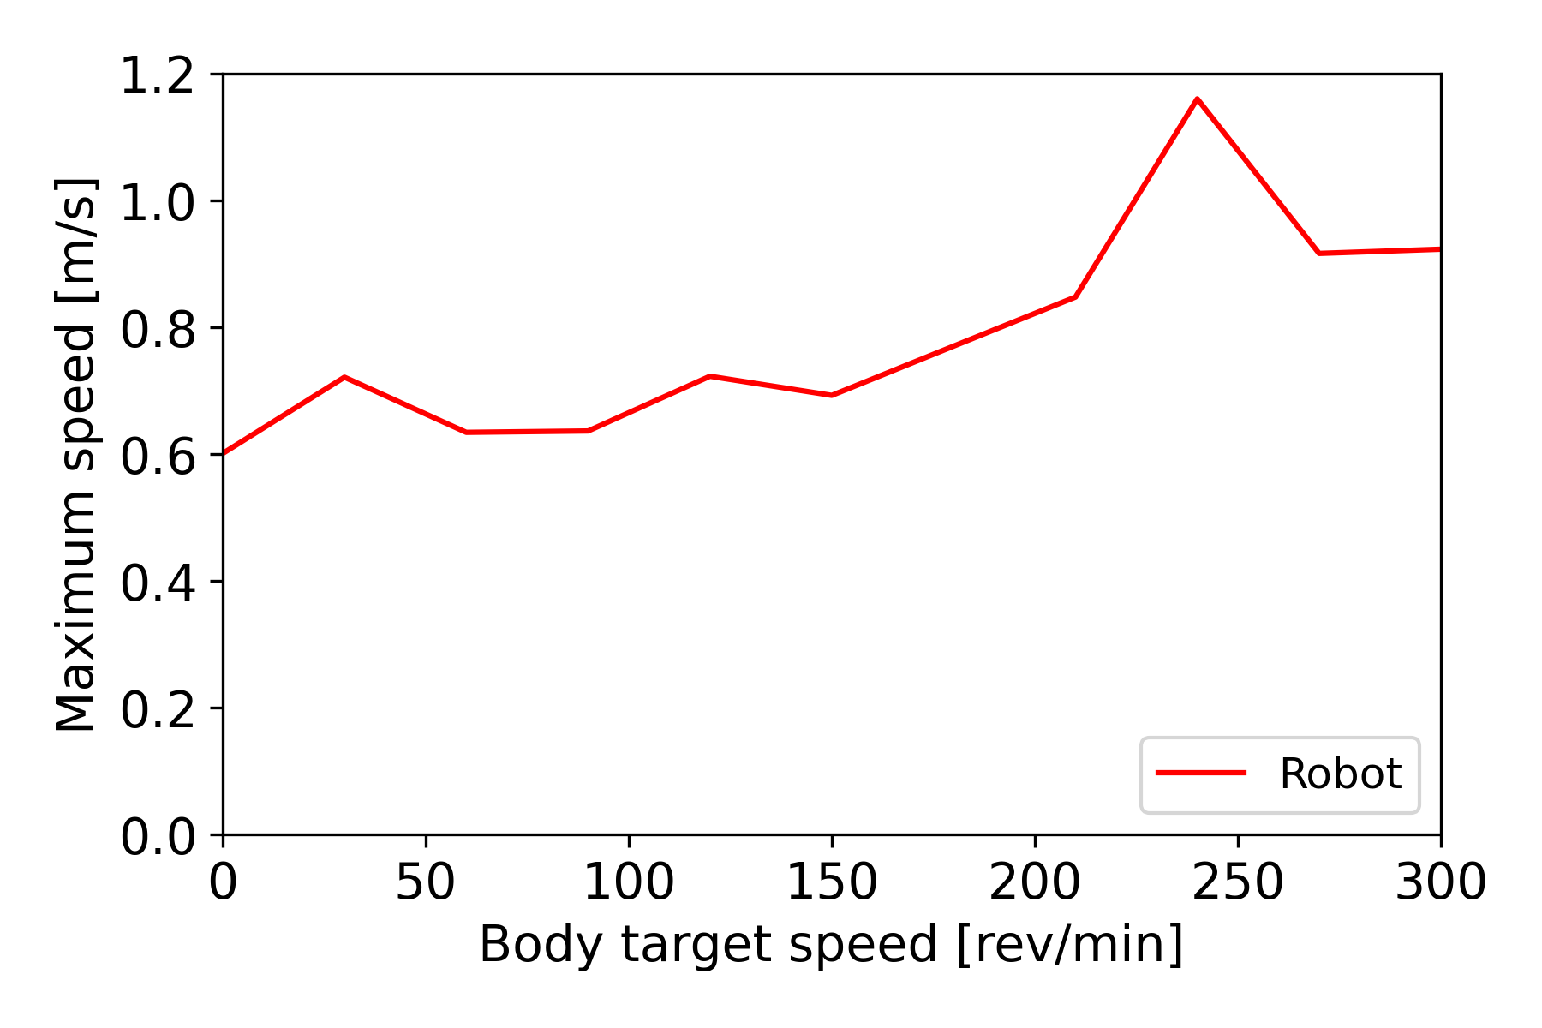
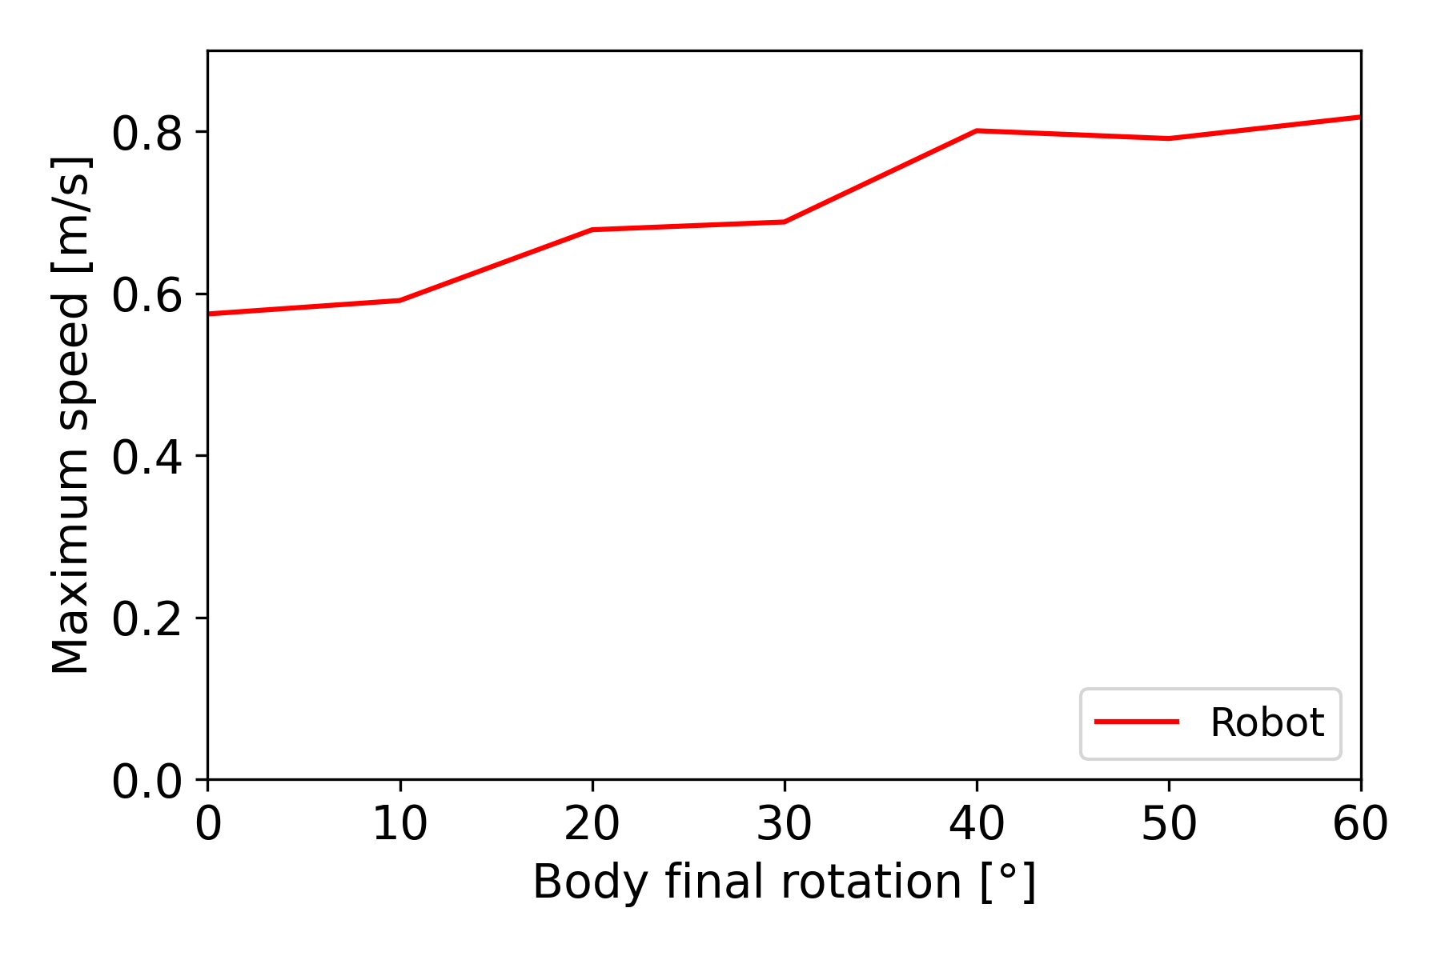
Velocity of impact
[rad/s]
Impact of the swing offset on the maximum speed of impact
Impact of the swing offset on the maximum speed of impact
Notes:
-35%W -23%M -25% R for 0 body rotation (and 0 speed)
+16%, + 28%, +6% for 60 degrees body rotation
+31% +34% +26% for 10 rad/s or 300 rev/min

Slide 31
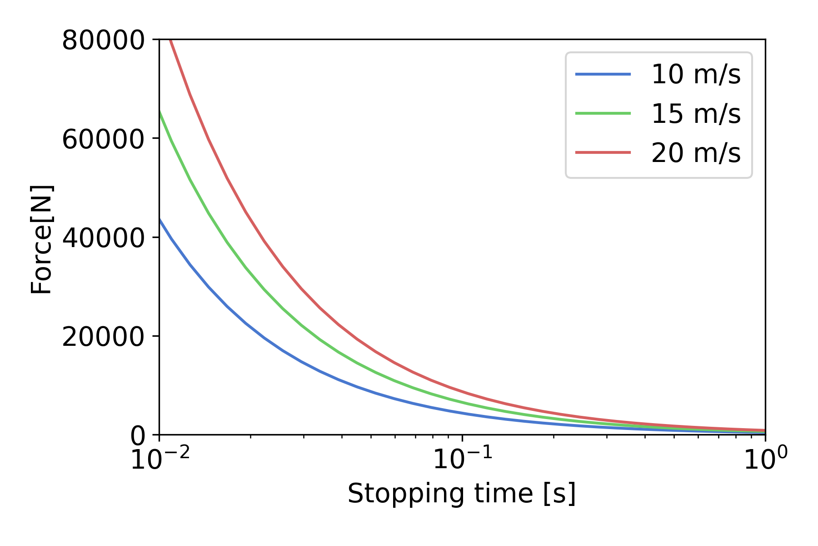
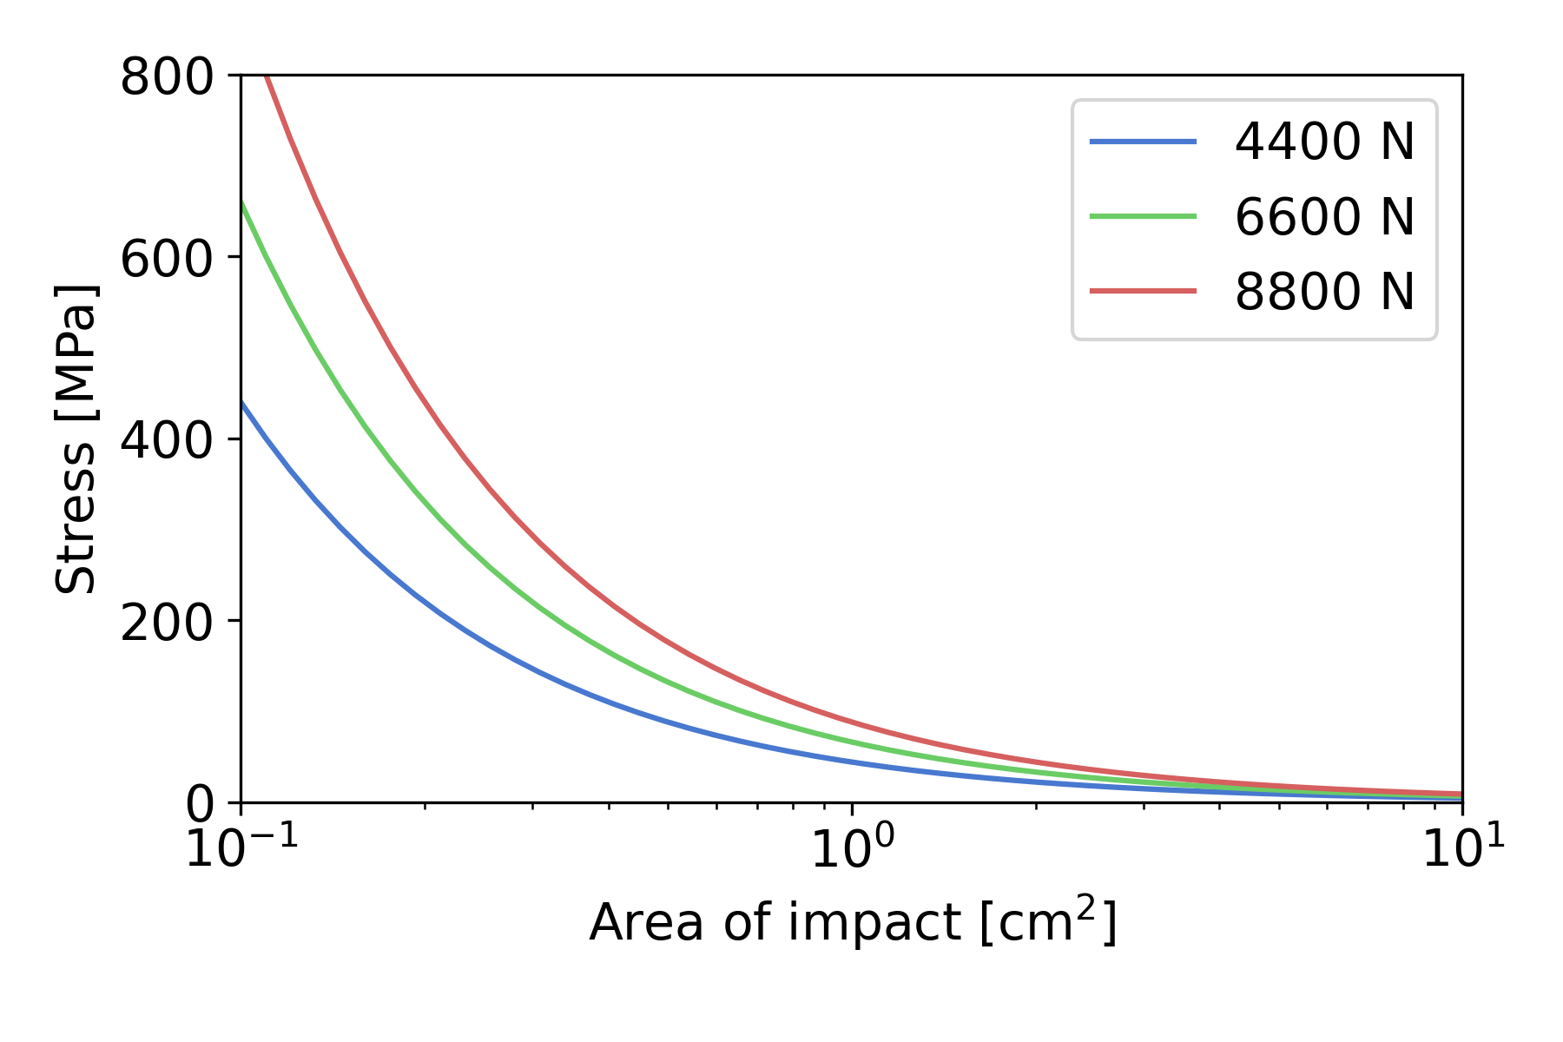
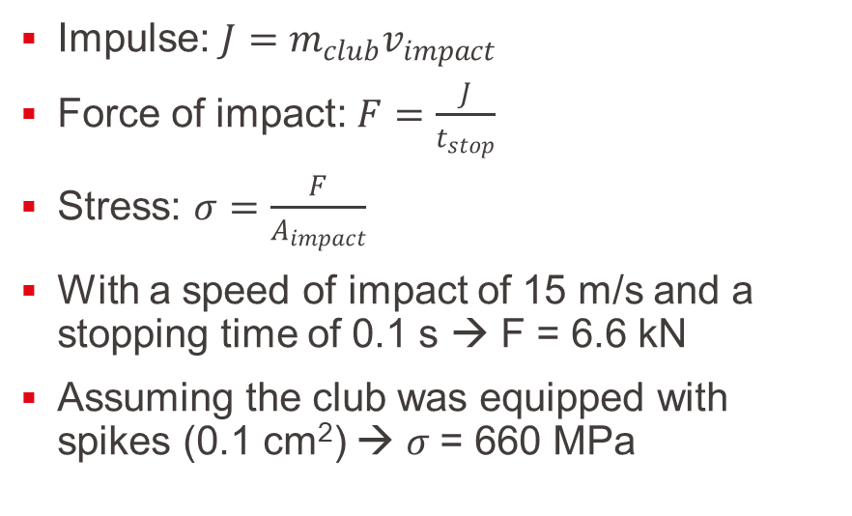
Analysis
Impulse: $J=m_{club}v_{impact}$
Force of impact: $F=\frac{J}{t_{stop}}$
Stress: $σ=\frac{F}{A_{impact}}$
With a speed of impact of 15 m/s and a stopping time of 0.1 s → F = 6.6 kN
Assuming the club was equipped with spikes (0.1 cm²) → $σ$= 660 MPa
Force depending on the stopping time
Master thesis presentation
Stress depending on the area of impact
Notes:
Could compute from speed of impact
2 graph
Sufficient to break bones since threshold is around 100 MPa

Slide 32
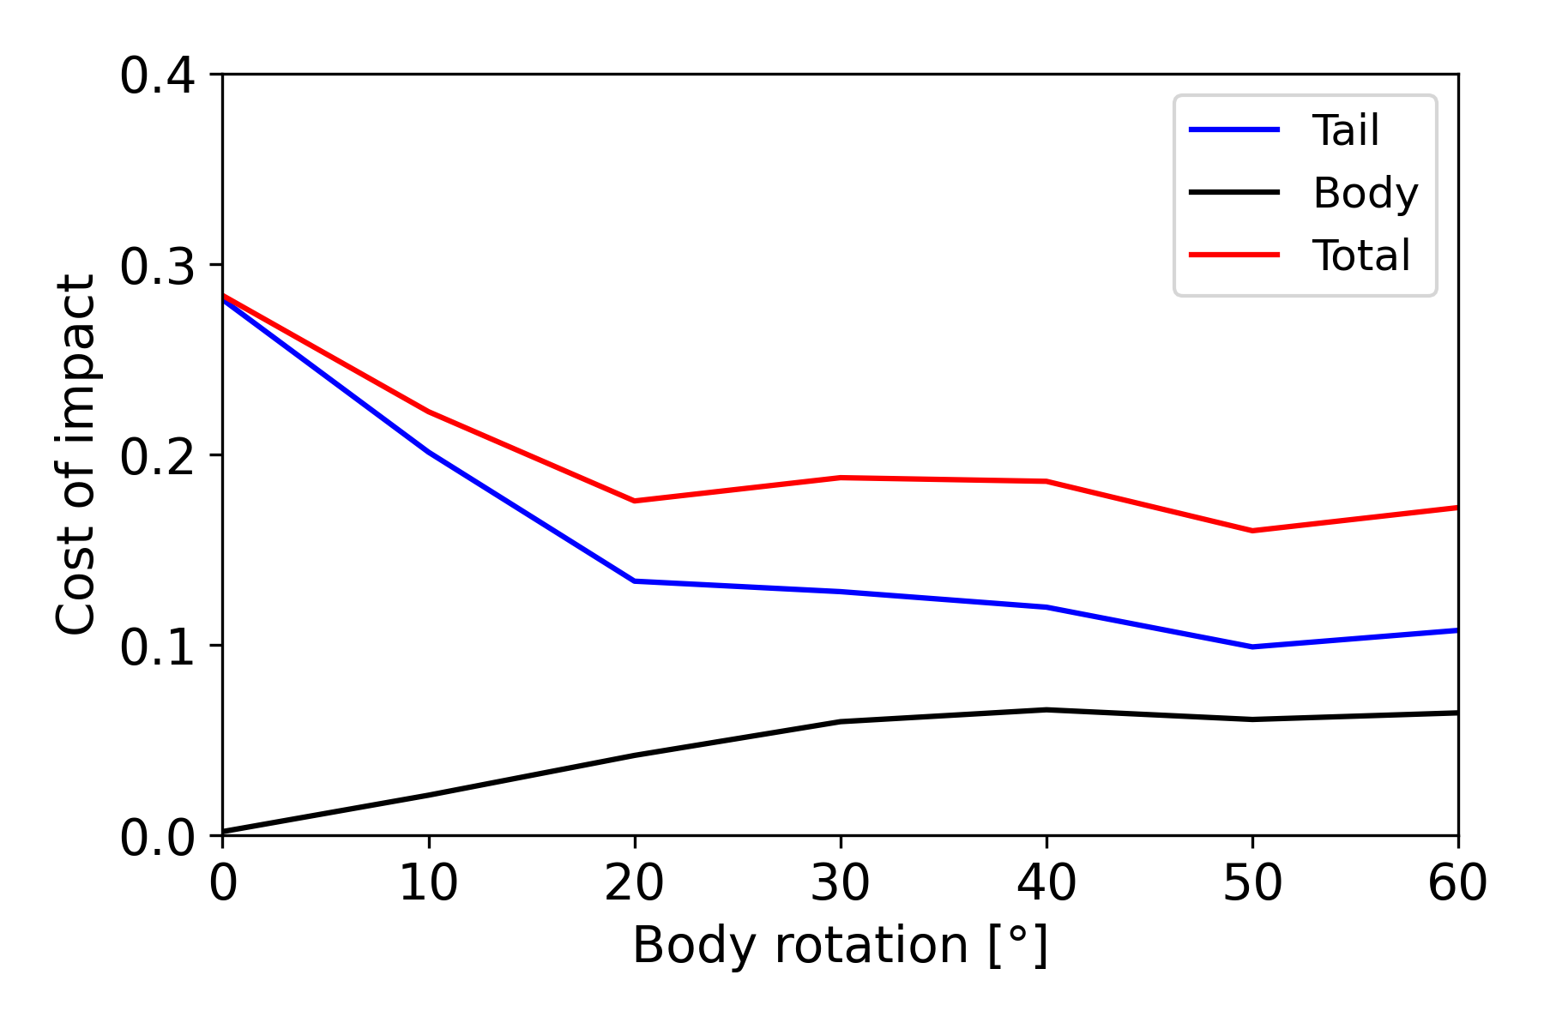
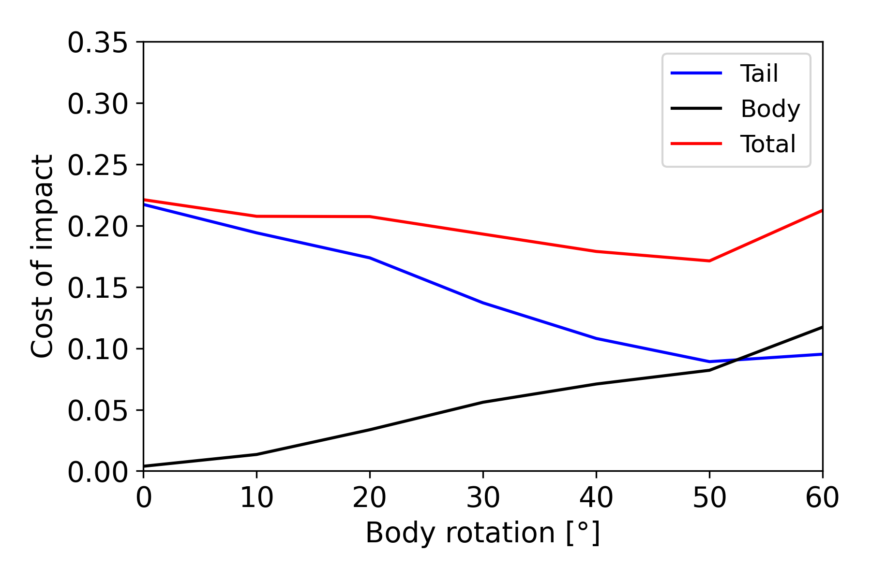
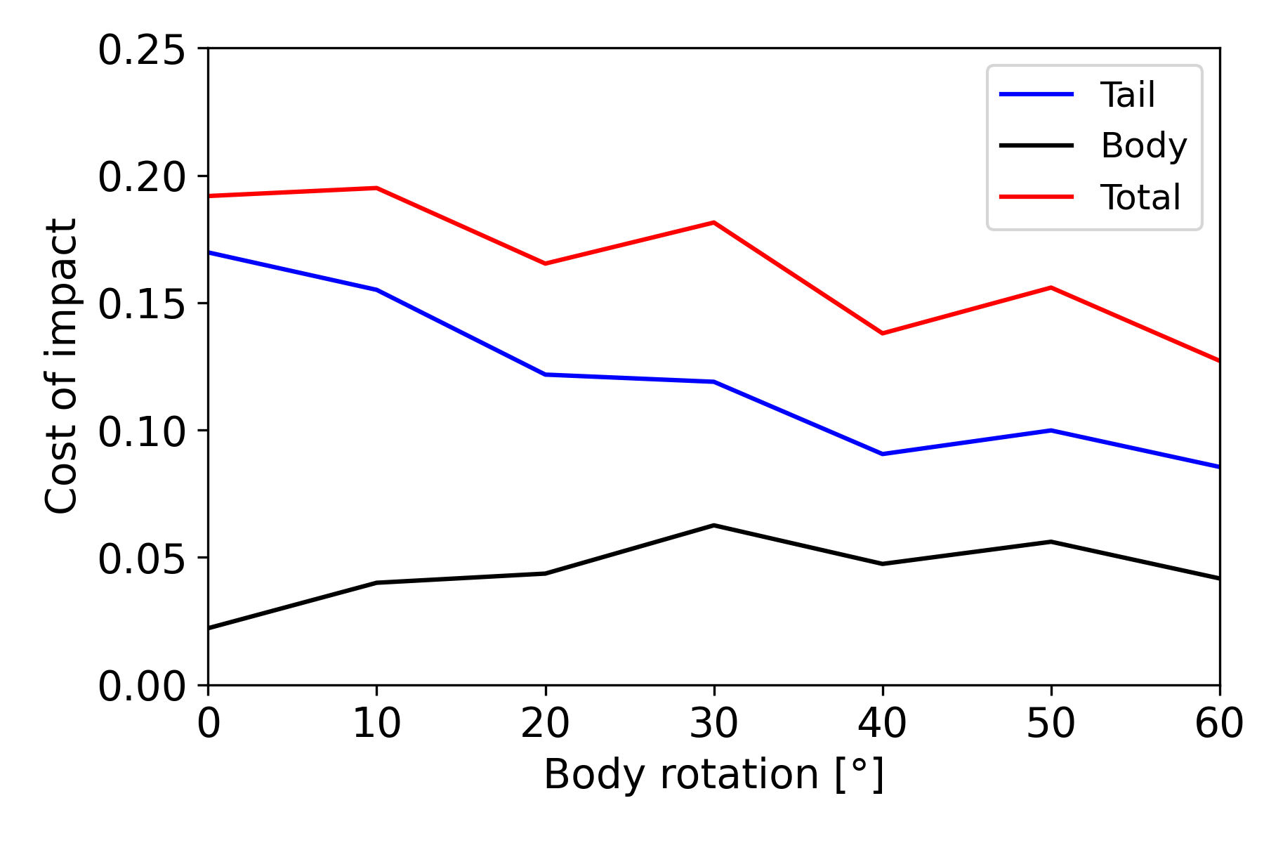
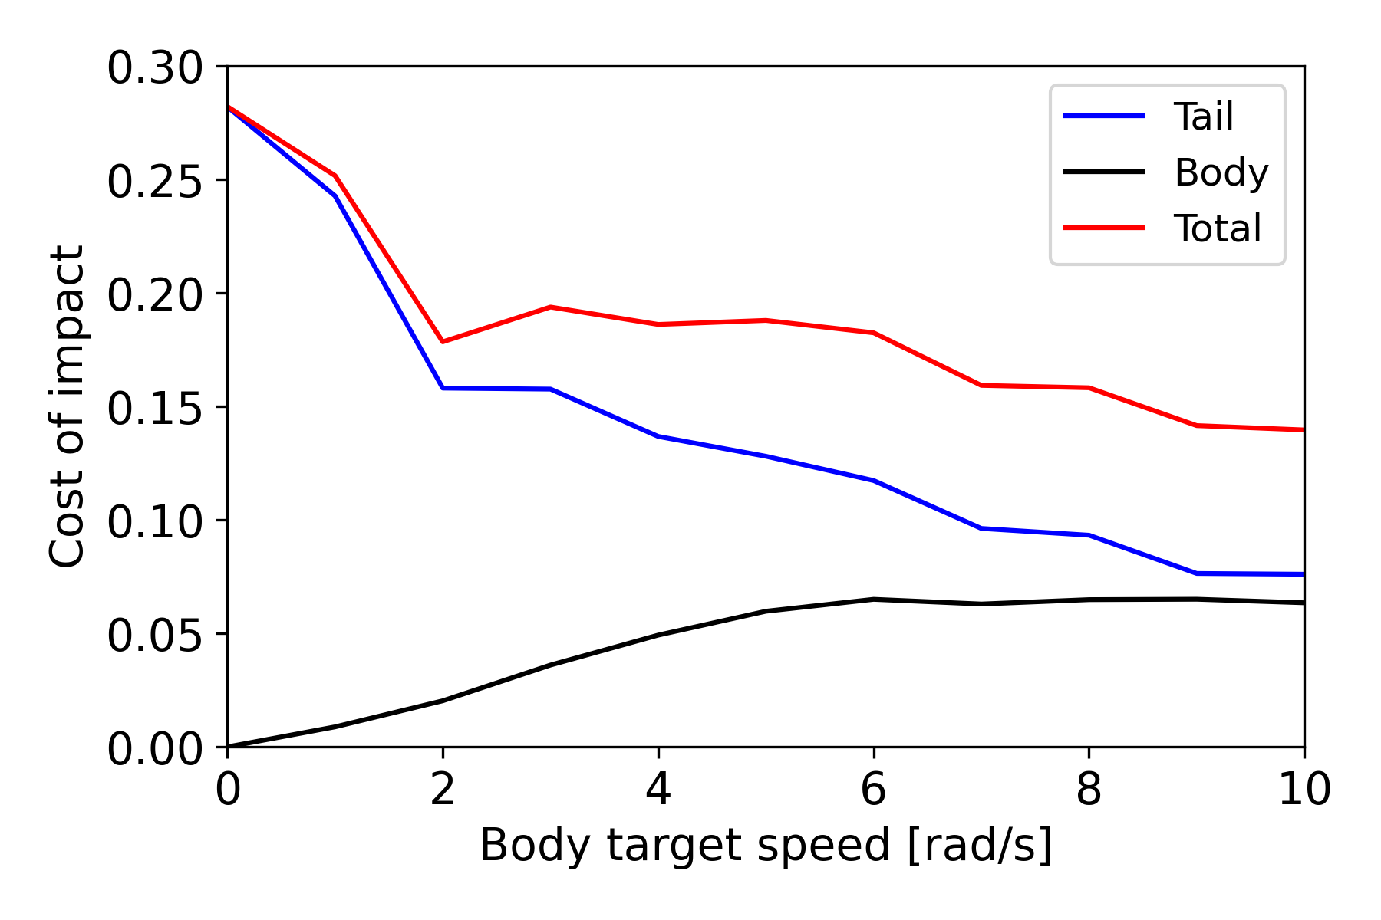
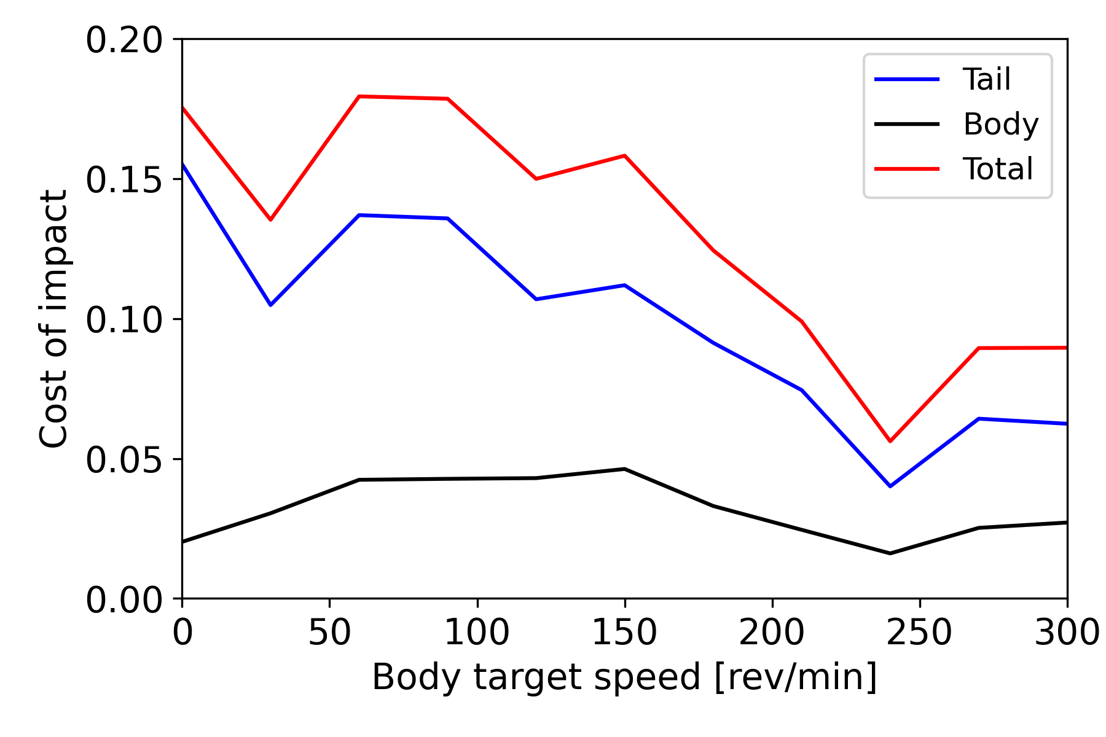

Analysis
Motor-driven
Tendon-driven
Robot
$$C_{impact, tail/body}=\frac{E_{used, tail/body}m_{club}}{m_{muscles, tail/body}E_{impact}}$$
Cost of impact depending on the body rotation and the body rotation speed
Notes:
Cost of impact to define energy efficiency
Tail and body separated
E_used/m_muscles → muscle rate
Lower cost → better

Slide 33
Summary
Velocity of impact in the simulations went from 8.5 m/s to 23.5 m/s depending on the parameters used
A preliminary swing increases the velocity of impact
A synchronized body movement with the tail blow increases the velocity of impact and decrease the cost of impact
Assuming a 0.1 second stopping time (Arbour V.M., 2009), the force of impact would probably range between 4400 N (10 m/s) and 8800 N (20 m/s)
Assuming the club was equipped with spikes, the stress would range from 440 to 880 Mpa (0.1 cm² impact area)

Slide 34
Discussion
Takeaways
Critical assessment and outlook
Conclusion

Slide 35
Takeaways
The velocity of impact could probably reach 15 to 20 m/s
This confirms Alexander R.M. and colleagues' findings
The club likely could fracture congeners carapace and bones
Using its body mass in a coordinated motion would have improved the velocity of impact as well as the energy efficiency of the blow
A preliminary swing in the opposite direction can be useful, both to maximize velocity by increasing the range of motion, and to store some potential energy which would then be distributed back to the tail’s motion
Notes:
Goal: impact potential and likely motion

Slide 36
Critical assessment and outlook
In the future, the robot and simulations design could be improved as :
Only one type of motion was tested (horizontal)
Lack of elasticity in the simulations and robot
Tendons are not as complex as muscles
The “body” mass of the robot is not coherent with the original body mass
Investigating into the structural properties of the tail club and of the carapace
Experimentation process could use some refinement
A more throughout energy efficiency analysis could be conducted
Notes:
(rotating platform)
Tendons not as complex, for example does not consider the variations in the muscles’ cross-sectional area
a diagonally downward strike for example could be the most efficient way to reach the highest speed possible by taking advantage of the gravity
Investigating into the structural properties of the tail club and of the carapace, could help to better estimate the forces on impact and potential fractures
A more throughout energy efficiency analysis could be conducted using optimizations for example

Slide 37
Conclusion
Results suggests that body movements and a preliminary swing are important to maximize the energy efficiency and impact forces
It is likely that the club could fracture carapace during intra-specific combat, which would have influenced the evolution of this caudal sheath into this formidable hammer
This thesis offers insights into the possible usages of glyptodonts tail club and proposes a different way of analyzing such movement by bridging the gap between paleontology and robotics

Slide 38

Thank you
Master thesis presentation
Reconstruction of Doedicurus, R.B. Horsfall

Slide 39
References
Alexander, R.M., FARIÑA, R.A. and VIZCAÍNO, S.F., 1999. Tail blow energy and carapace fractures in a large glyptodont (Mammalia, Xenarthra). Zoological Journal of the Linnean Society, 126(1), pp.41-49.
Blanco, R.E., Jones, W.W. and Rinderknecht, A., 2009. The sweet spot of a biological hammer: the centre of percussion of glyptodont (Mammalia: Xenarthra) tail clubs. Proceedings of the Royal Society B: Biological Sciences, 276(1675), pp.3971-3978.
Arbour, V.M., 2009. Estimating impact forces of tail club strikes by ankylosaurid dinosaurs. PLoS One, 4(8), p.e6738.
FARIÑA, R.A., 1995. Limb bone strength and habits in large glyptodonts. Lethaia, 28(3), pp.189-196.
Vizcaíno, S.F., Blanco, R.E., Bender, J.B. and Milne, N., 2011. Proportions and function of the limbs of glyptodonts. Lethaia, 44(1), pp.93-101.
Notes:
Alexander: tail blow up to 60 kN, determined volume of muscle and scutes using a cast,blow may fracture shell
Blanco: determined centre of percussion, support agonistic behaviour of doedicurus, used measurements
Arbour: method for estimating impact force of tail club strikes for ankylosaurid dinosaurs

Slide 40
Forces and torques
Derived from the muscles cross-sectional area and length
Using 20 N/cm² as a specific tension for concentric contraction (V.M. Arbour, 2009)
Segment | Cross sectional radius at proximal end [cm] | Cross sectional area at proximal end [cm²] | Cross sectional area of muscle [cm²] | Force [kN] | Muscle half width [cm] | Torque at base of link [Nm]
1 |  |  | 810 | 8.10 | 20 | 1620
2 | 32 | 3285 | 2190 | 21.90 | 5.5 | 1205
3 | 27 | 2281 | 1521 | 11.21 | 5.5 | 836
4 | 22 | 1584 | 1056 | 10.56 | 5.5 | 581
5 | 19 | 1100 | 733 | 7.34 | 5.5 | 403
6 | 16 | 764 | 509 | 5.09 | 5.5 | 280
Club | 13 | 531 | 354 | 3.54 | 5.5 | 195

Slide 41

Vertebrae
Notes:
1.5 cm intervertebrate disc
Between 1/8 and a ¼ of the maximum overlap value
Camel, Ostrich neck → 20, 25 degrees lateral

Slide 42

Vertebrae

Slide 43




Real scale ?
The total mass of the tail is around 180 kg making it difficult to design a full-scale robot
A simplified version was imagined:
Actuated by 6 kNm hydraulic motor at EMPA
A steel rod with a square (d ~ 70mm) or round section (d ~ 80mm) would mimic the caudal sheath
Combined with a “bone-like” tip using synthetic bone
A second option was to use a transport chain and rigidify some section of the chain with steel plate to represents the links, the system would then be actuated using tendons
→ Postponed
Generic bloc, Synbone
Generic sphere, Synbone
Notes:
In contact with Angelo but hard to get correct mass

Slide 44



Rotating platform
25x25 square base using aluminum profile and a MDF plate
Aluminium plate to rigidify the rotating platform
Ball bearing support to limit the pressure on the motor axis
MDF rotating platform

Slide 45

String
First experimented with 0.65 nylon string:
12 kg maximum weight
Low friction
But easily lose some tension and knot can become loose over timer
Instead, Zeus HPPE Braided Line was used:
0.6 mm wide
65 kg maximum weight
Higher friction but the effect is negligible as the passthrough holes are 2 mm wide

Slide 46

Tail support
2 printed support for the motor
3D printed horn reinforced with carbon fiber
Tensioning system
MDF vertical plate to fix the tail fixed with 2 square brackets
2 stopper to stop the first vertebrae at a 10 degrees angle

Slide 47

Tail
6 vertebra and the club
3D printed with laser sintered (SLS) technology in PA220
Aluminium axis for solid joints
Teflon inserts to limit friction
Holes on each side of the vertebrae for the string to pass through
5 degrees inclined faces to limit the mobility of the joints
Additional axis going through the proximal part of the club to attach the strings

Slide 48





Velocity of impact

